Slide 1
Home Retail
Consumer Monitor
Presented March 9, 2021

Slide 2

Methodology
N = 558
MOE ± 4.15%
Panel: General Population
Collected: 3/2/21, 3/3/21

Slide 3
Panel Composition
21%
17%
24%
38%

Slide 4


Slide 5

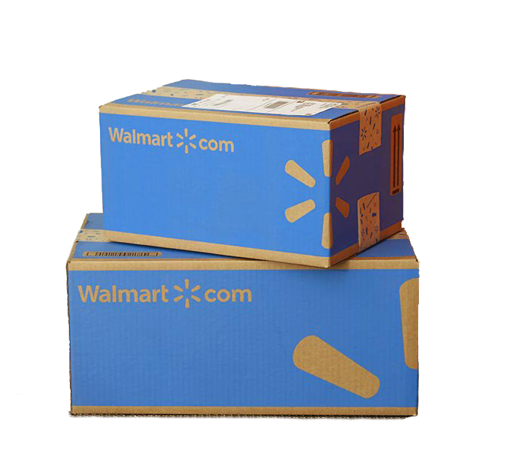
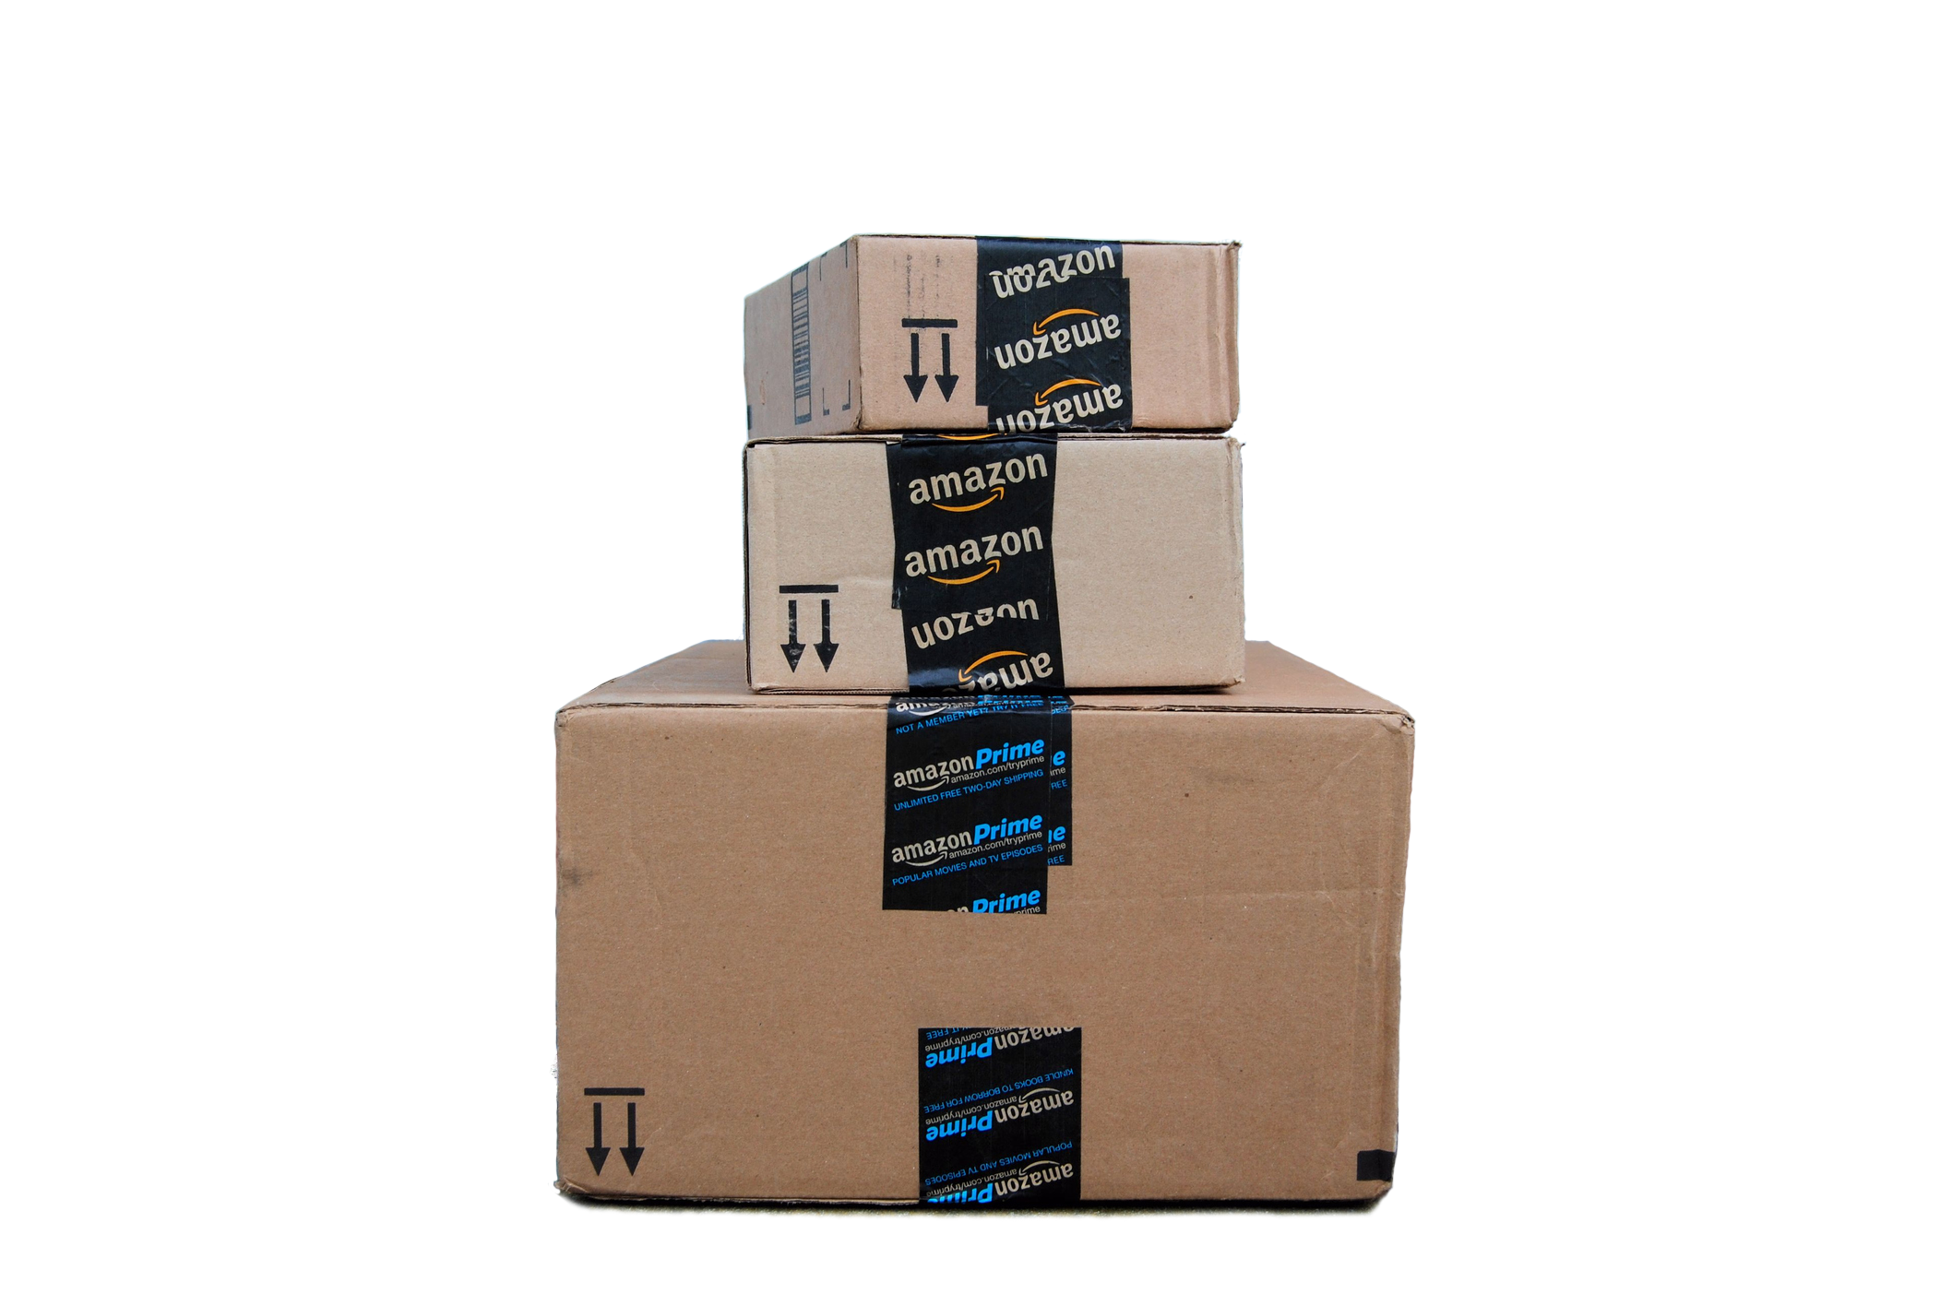
Walmart & Amazon

Slide 6
Nearly two-thirds (66%) of the sample report being an Amazon Prime member.
Are you an Amazon Prime member?

Slide 7
At 22%, Walmart+ membership is one-third the size of Prime and only 9% among Boomers.
Are you a Walmart+ member?

Slide 8
The memberships are far from mutually exclusive. 27% of Amazon Prime members are also Walmart+ subscribers while 77% of Walmart+ members also belong to Prime.
Are you a Walmart+ member?
Are you an Amazon Prime member?

Slide 9
Among those shopping at Walmart, groceries (78%) and HBA (67%) are the most popular categories.
Which of the following product categories do you typically or often buy from Walmart? Select all that apply.

Slide 10

Clothes and shoes (52%) are the most commonly purchased categories on Amazon.
Which of the following product categories have you purchased from Amazon.com in the past year? Select all that apply.

Slide 11
Amazon Prime members shop for groceries at Walmart more than they do on Amazon (80% vs. 52%). The same is true for HBA (72% vs. 60%).
Which of the following product categories do you typically or often buy from Amazon.com in the past year? Select all that apply.
Which of the following product categories do you typically or often buy from Walmart? Select all that apply.

Slide 12

Home

Slide 13
Perceptions of home value remain high. 56% of homeowners see their home as more valuable than a year ago while only 17% feel it is worth less.
If you were to sell your home today how much more or less do you think it would sell for than it would have a year ago?

Slide 14
Given the perceived increase in value, it’s not surprising that 56% of homeowners plan to invest in home improvements in the coming year.
In the next year, how likely are you to make investments (improvements) in your home?

Slide 15

Men (60%) are slightly more likely to be planning home improvements than women (53%).
Which of the following product categories have you purchased from Amazon.com in the past year? Select all that apply.

Slide 16
Among the 16% of homeowners considering the purchase of a new property in the coming year, 52% expect that it will be more expensive than their current home while only 17% think it will be less.
On a scale from 1 (much less expensive) to 5 (much more expensive): Thinking about the home you plan to purchase, how much more or less expensive will it be than your current home?

Slide 17
Men (58%) are more likely than women (46%) to be planning a trade up.
On a scale from 1 (much less expensive) to 5 (much more expensive): Thinking about the home you plan to purchase, how much more or less expensive will it be than your current home?

Slide 18
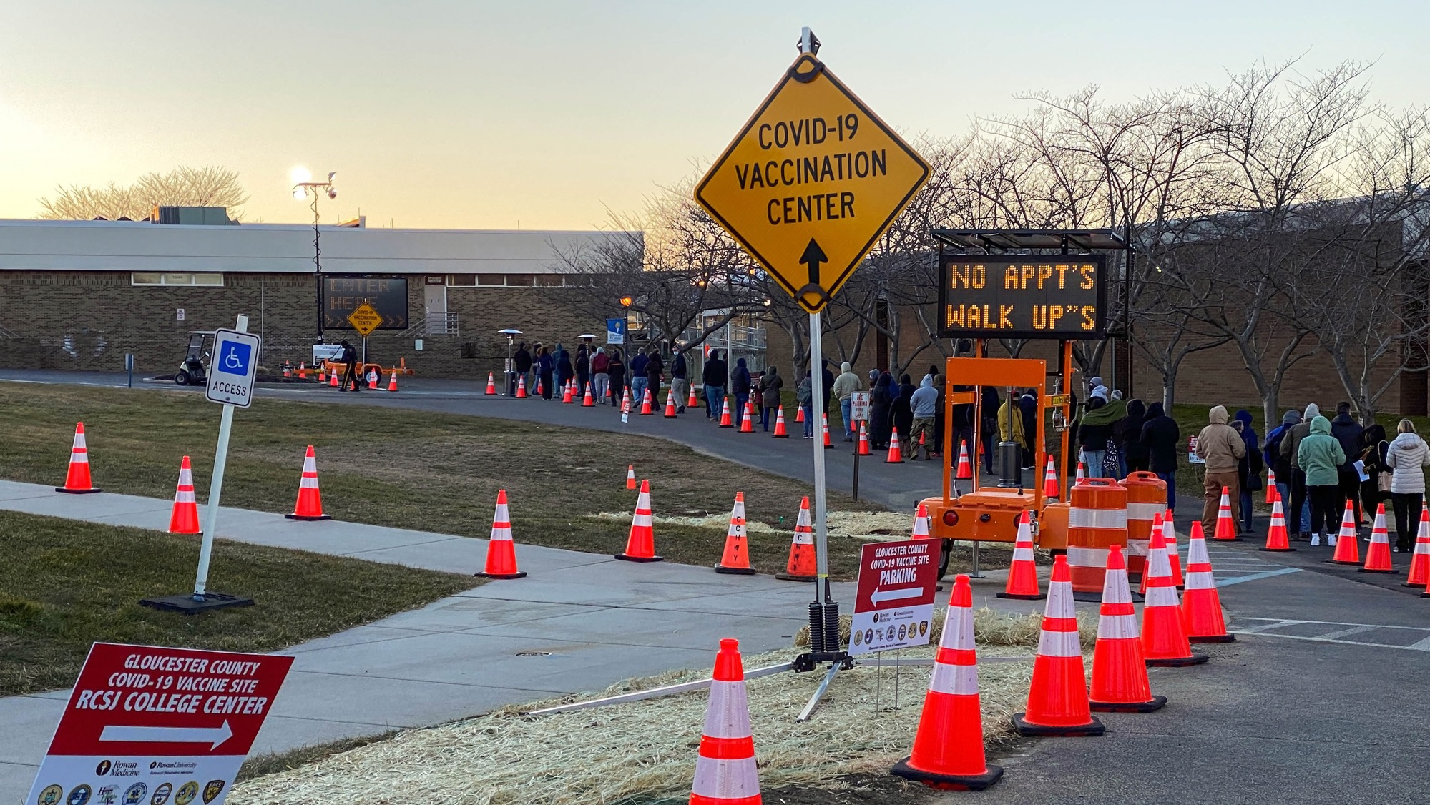
COVID-19 Vaccine

Slide 19
Of the 23% of people not planning on getting the vaccine, the greatest concerns are safety (72%) and effectiveness (69%). One-third, however, don’t believe in vaccines and a quarter don’t see a threat.
How influential are the following on your decision not to get the vaccine?

Slide 20
Awareness of the new Johnson & Johnson vaccine is 83% and is highest among Boomers at 94%.
Are you aware that the Food and Drug Administration has approved a new COVID-19 vaccine from Johnson and Johnson?

Slide 21
69% of those willing to receive any vaccine will get the J&J version. 31% will wait for the Moderna or Pfizer version to be available to them.
If you have the opportunity to get the single dose Johnson & Johnson vaccine will you do so?

Slide 22
Among those who will wait, many factors are at work, the leading one being the higher efficacy of the Moderna and Pfizer versions (32%).
How influential are the following on your decision to wait for the Moderna or Pfizer vaccines?

Slide 23
Summary
Nearly two-thirds (66%) of the sample reports being an Amazon Prime member.
At 22%, Walmart+ membership is one-third the size of Prime and only 9% among Boomers.
The memberships are far from mutually exclusive. 27% of Amazon Prime members are also Walmart+ subscribers while 77% of Walmart+ members also belong to Prime.
Among those shopping at Walmart, groceries (78%) and HBA (67%) are the most popular categories.
Clothes and shoes (52%) are the most commonly purchased categories on Amazon.
Amazon Prime members shop for groceries at Walmart more than they do on Amazon (80% vs. 52%). The same is true for HBA (72% vs. 60%).
Walmart and Amazon

Slide 24
Summary
Perception of home value remains high. 56% of homeowners see their home as more valuable than a year ago while only 17% feel it is worth less.
Given the perceived increase in value, it’s not surprising that 56% of homeowners plan to invest in home improvements in the coming year.
  Men (60%) are slightly more likely to be planning home improvements than women (53%).
Among the 16% of homeowners considering the purchase of a new property in the coming year 52% expect that it will be more expensive than their current home while only 17% think it will be less.
  Men (58%) are more likely than women (46%) to be planning a trade up.
Home

Slide 25
Summary
Of the 23% of people not planning on getting the vaccine, the greatest concerns are safety (72%) and effectiveness (69%). One-third, however, don’t believe in vaccines and a quarter don’t see a threat.
Awareness of the new Johnson & Johnson vaccine is 83% and is highest among Boomers at 94%.
69% of those willing to receive any vaccine will get the J&J version. 31% will wait for the Moderna or Pfizer version to be available to them.
Among those who will wait, many factors are at work, the leading one being the higher efficacy of the Moderna and Pfizer versions (32%).
COVID-19 Vaccinations

