Slide 1
Home Retail Monitor
June 10, 2022

Slide 2
Methodology
N = 517
MOE ± 4.31%
Panel: General Population
Collected: 6/3/22, 6/4/22

Slide 3
21%
17%
24%
38%

Slide 5
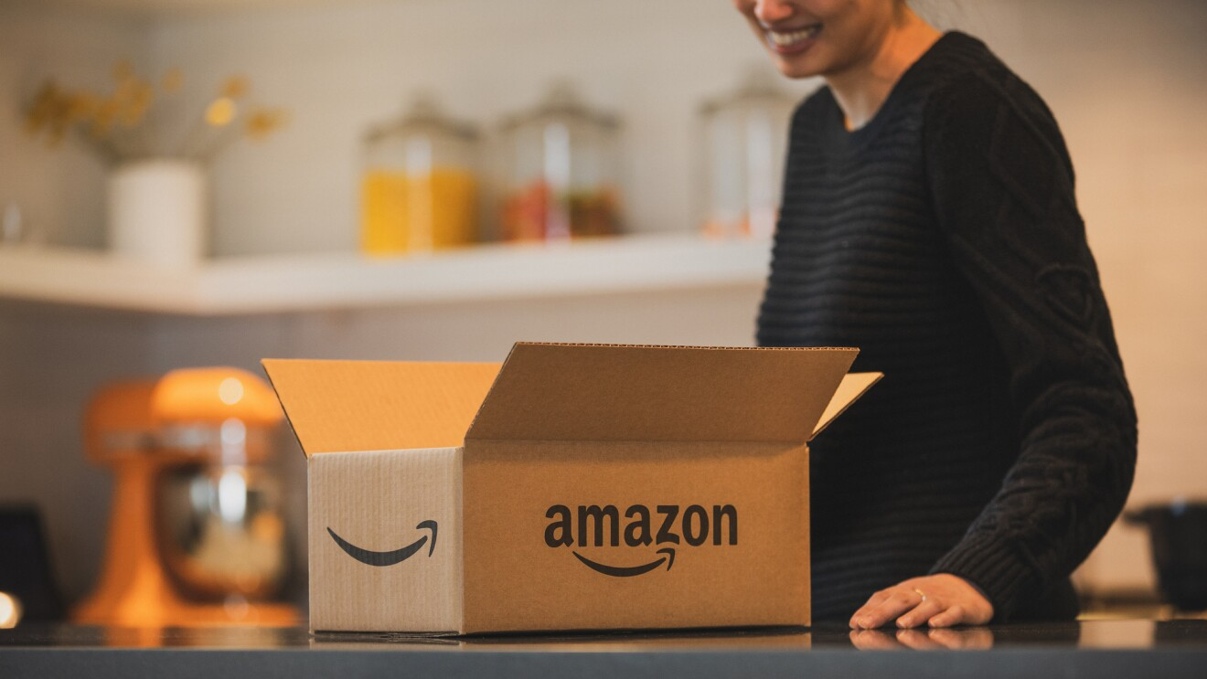
Amazon
5

Slide 6
6
78% of respondents report having made online purchases at Amazon in the past year. Walmart.com trails at 55%.
At which of the following have you made online purchases in the past year? Select all that apply.

Slide 7
7
While Amazon is clearly the most popular online destination, only a small portion of respondents (10%) use Amazon for 80% or more of their online purchases.
Approximately what percent of your online shopping is done at Amazon?

Slide 8
8
Amazon continues to attract new shoppers with 8% of shoppers just having begun their relationship in the past year.
How long have you been shopping at Amazon?

Slide 9
9
71% of Amazon shoppers are Prime members including almost 2 of every 3 Boomers (64%).
Are you an Amazon Prime member?

Slide 10
10
Prime membership continues to increase. While only 8% of Amazon shoppers report being new this year, 15% of Prime members are new.
How long have you been an Amazon Prime member?

Slide 11
11
The median annual spend on Amazon is approximately $800. Fewer than half of all shoppers (61%) are spending more than $1000 annually.
Approximately how much money do you spend at Amazon in a normal year?

Slide 12
12
Not surprisingly, Amazon spending has increased for significantly more people (41%) than it has declined (15%) since the arrival of Covid.
Since the outbreak of COVID-19 how has your spending at Amazon changed?

Slide 13
13
Among those whose Amazon spending has declined, it is more a function of inflation (65%) or income reduction (49%) than dissatisfaction with Amazon or having found a shopping destination they prefer over Amazon.
How influential have the following been on your reduction of spending at Amazon?

Slide 14
14
Despite the pressures of inflation, respondents anticipate spending slightly more with Amazon in the back half of the year than they did in the first half.
How do you think your spending at Amazon in the 2nd half of the year (July-December) will compare to the money you spent with Amazon in the first half of 2022 (January-June)?

Slide 15
15
63% of shoppers visit Amazon one or more times a week. Only 1 person in 5 visits once a month or less.
Approximately, how frequently do you visit the Amazon website?

Slide 16
16
The median duration of an Amazon visit is about 20 minutes. Only 3% of shoppers typically spend more than an hour.
Approximately how long do your visits to the Amazon website last?

Slide 17
17
No category of product has universal appeal. Shoppers are most likely to be looking at electronics (58%), clothing (55%), and personal care items (53%).
Which of the following product categories have or will you shop for at Amazon?

Slide 18
18
Not everyone inclined to shop a category at Amazon necessarily begins there. For example, 58% say they would shop Amazon for electronics, but only 39% would start their shopping journey there.
For which of the following product categories are you most likely to start your shopping at Amazon? Select all that apply.

Slide 19
19
When not familiar with a product category, Amazon shoppers are nearly 1.5X as likely to begin their search on a search engine than on Amazon (46% vs. 31%).
For a product category you’re not familiar with (something new to you) where are you most likely to start your search?

Slide 20
20
Men (38%) are much more likely to initiate a search in an unknown category on Amazon than are women (24%).
For a product category you’re not familiar with (something new to you) where are you most likely to start your search?
Notes:
Amazon

Slide 21
21
Boomers are much more likely than the other generations to begin searches at the category level (46%) rather than a brand focus (23%).
When entering a search in the search bar do you typically just specify the product category (for example: running shoes) or do you typically identify a category and a brand also (for example: Nike running shoes) or just the brand (for example: Nike)?

Slide 22
22
Boomers are far and away the least likely to take advantage of the tools Amazon provides.
Which of the following special Amazon functions have you used? Select all that apply.

Slide 23
23
Nearly two-thirds of respondents (64%) and a majority of all generations do research on Amazon for products they intend to purchase elsewhere.
Do you ever use Amazon to research a product you plan to buy somewhere else?

Slide 24
24
AmazonBasics have yet to become a staple for most people. 36% of Amazon shoppers have never purchased AmazonBasics products while only 7% say they do so regularly.
How frequently have you purchased AmazonBasics products?

Slide 25
25
In the 2 years since the arrival of COVID, there has been a slight uptick in AmazonBasics purchases.
July 2020 – June 2022 comparison of the frequency of purchasing AmazonBasics products
How frequently have you purchased AmazonBasics products?

Slide 26
Summary
26
78% of respondents report having made online purchases at Amazon in the past year. Walmart.com trails at 55%.
While Amazon is clearly the most popular online destination, only a small portion of respondents (10%) use Amazon for 80% or more of their online purchases.
Amazon continues to attract new shoppers with 8% of shoppers just having begun their relationship in the past year.
71% of Amazon shoppers are Prime members including almost 2 of every 3 Boomers (64%).
Prime membership continues to increase. While only 8% of Amazon shoppers report being new this year, 15% of Prime members are new.
The median annual spend on Amazon is approximately $800. Fewer than half of all shoppers (61%) are spending more than $1000 annually.
Not surprisingly, Amazon spending has increased for significantly more people (41%) than it has declined (15%) since the arrival of Covid.
Among those whose Amazon spending has declined, it is more a function of inflation (65%) or income reduction (49%) than dissatisfaction with Amazon or having found a shopping destination they prefer over Amazon.
Amazon

Slide 27
Summary
27
Despite the pressures of inflation, respondents anticipate spending slightly more with Amazon in the back half of the year than they did in the first half.
63% of shoppers visit Amazon one or more times a week. Only 1 person in 5 visits once a month or less.
The median duration of an Amazon visit is about 20 minutes. Only 3% of shoppers typically spend more than an hour.
No category of product has universal appeal. Shoppers are most likely to be looking at electronics (58%), clothing (55%), and personal care items (53%).
Not everyone inclined to shop a category at Amazon necessarily begins there. For example, 58% say they would shop Amazon for electronics but only 39% would start their shopping journey there.
When not familiar with a product category, Amazon shoppers are nearly 1.5X as likely to begin their search on a search engine than on Amazon (46% vs. 31%).
Men (38%) are much more likely to initiate a search in an unknown category on Amazon than are women (24%).
Amazon cont.

Slide 28
Summary
28
Boomers are much more likely than the other generations to begin searches at the category level (46%) rather than a brand focus (23%).
Boomers are far and away the least likely to take advantage of the tools Amazon provides.
Nearly two-thirds of respondents (64%) and a majority of all generations do research on Amazon for products they intend to purchase elsewhere.
AmazonBasics have yet to become a staple for most people. 36% of Amazon shoppers have never purchased AmazonBasics products while only 7% say they do so regularly.
In the 2 years since the arrival of COVID there has been a slight uptick in AmazonBasics purchases.
Amazon cont.

