Slide 1
Home Retail Monitor
June 28, 2022

Slide 2
Methodology
N = 771
MOE ± 3.529%
Panel: General Population
Collected: 6/17/22, 6/18/22

Slide 3
21%
17%
24%
38%

Slide 5
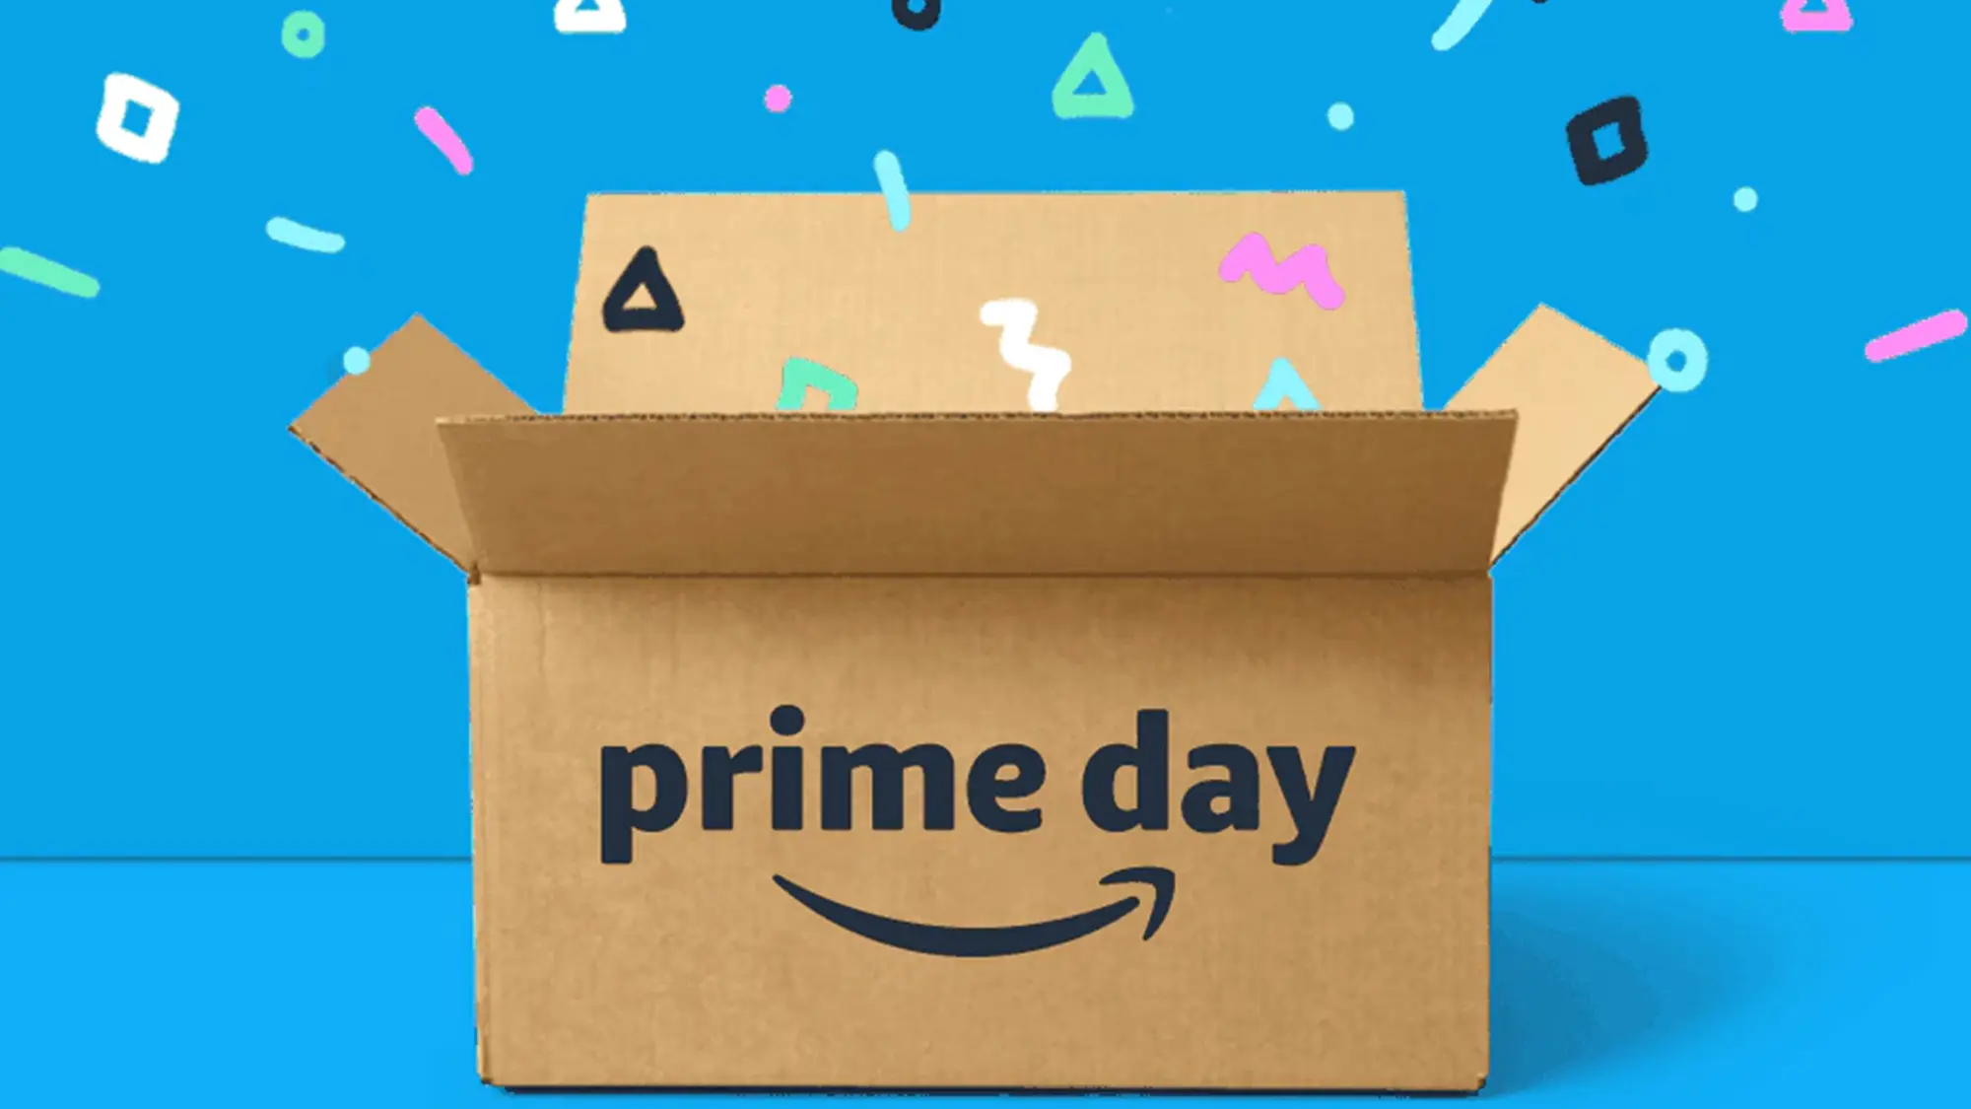
Amazon Prime Day
5

Slide 6
6
Nearly two-thirds (66%) of respondents are
Amazon Prime members.
Are you an Amazon Prime member?

Slide 7
7
Among the Prime members, 68% are planning on shopping during the upcoming Prime Day.
Amazon Prime Day will likely occur during the 2nd week of July. Will you be making Amazon Purchases on Prime Day?

Slide 8
8
Among those not planning Prime Day purchases, concerns about future inflation (48%), high gas prices (47%), and the increasing costs of other items (47%) are the biggest influences.
How influential are the following on your decision to not make purchases from Amazon on Prime Day?

Slide 9
9
The high gas prices are not as big a concern for Gen Z (36%) as they are for the other generations (44%+).
How influential are the following on your decision to not make purchases from Amazon on Prime Day?

Slide 10
10
The increasing prices of things other than gas are significantly less influential on the Prime Day plans of Gen Z (23%) than they are for other generations (45-53%).
How influential are the following on your decision to not make purchases from Amazon on Prime Day?

Slide 11
11
While only 68% of Prime members are planning Prime Day purchases, nearly 4 in 5 (79%) have made purchases in the past.
Have you made purchases from Amazon on Prime Day in past years?

Slide 12
12
Among those planning to make Prime Day purchases, 28% are planning on spending at least somewhat more than they have in prior years while 23% are planning on spending less.
Are you planning on spending more or less money on Amazon during Prime Day this year vs. past years?

Slide 13
13
Among those who will participate but spend less, the motivations are remarkably similar to those who are not participating. Concern about the rising prices of gas and things other than gas and concern about future inflation are influencing 3 people in 4.
How influential are the following on your decision to not make purchases from Amazon on Prime Day?

Slide 14
14
As was the case among those choosing not to shop Prime Day, Gen Z (45%) is much less influenced by high gas prices than the other generations (79-83%).
How influential are the following on your decision to not make purchases from Amazon on Prime Day?

Slide 15
15
The gap between Gen Z and other generations narrows dramatically when it comes to the impact of the increase in the prices of things other than gas.
How influential are the following on your decision to not make purchases from Amazon on Prime Day?

Slide 16
16
Among those planning on spending more on Prime Day than they have in the past, an increase in income, needing more than they have in the past, and doing more holiday shopping are all significant influences (72%+).
How influential are the following on your plan to spend more on Amazon Prime Day than in years past?

Slide 17
17
Most Prime Day shoppers are buying good deals (58%) as opposed to sticking to a budget by item (23%) or in aggregate (19%).
Which of the following best describes your approach to budgeting your Prime Day spending?

Slide 18
18
Nearly 3 people in 4 (72%) say 40-80% of their spending on Prime Day will be regular as opposed to holiday shopping.
What % of your spending on Amazon during Prime Day do you think will fall in these two categories? Total must equal 100%.

Slide 19
19
71% of Prime Day shoppers say 20-80% of their spending will be on holiday items.
What % of your spending on Amazon during Prime Day do you think will fall in these two categories? Total must equal 100%.

Slide 20
20
Only slightly more than one-third of respondents (37%) plan to take advantage of deals at retailers other than Amazon during Prime Day.
Many other retailers (Walmart, Target, Best Buy, etc.) run specials to compete with Amazon’s Prime Day offers. How likely are you to shop other retailers during Prime Day?

Slide 21
21
Among those shopping retailers other than Amazon, Walmart (74%) and Target (50%) are the most popular destinations.
Which other retailers are you likely to shop on Prime Day? Select all that apply.

Slide 22
22
Nearly half (49%) of those shopping Prime Day has an item or items that they have delayed purchasing in order to get the best possible price.
Are there purchases you’ve been planning but are waiting for Prime Day to get the best possible price?

Slide 23
Summary
23
Nearly two-thirds (66%) of respondents are Amazon Prime members.
Among the Prime members, 68% are planning on shopping Prime Day which is scheduled for 7/12-13.
Among those not planning Prime Day purchases, concern about future inflation (48%), high gas prices (47%), and the increasing costs of other items (47%) are the biggest influences.
The high gas prices are not as big a concern for Gen Z (36%) as they are for the other generations (44%+).
The increasing prices of things other than gas are significantly less influential on the Prime Day plans of Gen Z (23%) than they are for other generations (45-53%).
While only 68% of Prime members are planning Prime Day purchases, nearly 4 in 5 (79%) have made purchases in the past.
Among those planning to make Prime Day purchases, 28% are planning on spending at least somewhat more than they have in prior years while 23% are planning on spending less.
Amazon Prime Day

Slide 24
Summary
24
As was the case among those choosing not to shop on Prime Day, Gen Z (45%) is much less influenced by high gas prices than the other generations (79-83%).
The gap between Gen Z and other generations narrows dramatically when it comes to the impact of the increase in the prices of things other than gas.
Among those planning on spending more on Prime Day than they have in the past, an increase in income, needing more than they have in the past, and doing more holiday shopping are all significant influences (72%+).
Most Prime Day shoppers are buying good deals (58%) as opposed to sticking to a budget by item (23%) or in aggregate (19%).
Nearly 3 people in 4 (72%) say 40-80% of their spending on Prime Day will be regular as opposed to holiday shopping.
71% of Prime Day shoppers say 20-80% of their spending will be on holiday items.
Only slightly more than one-third of respondents (37%) plan to take advantage of deals at retailers other than Amazon during Prime Day.
Amazon Prime Day – cont.

Slide 25
Summary
25
Among those shopping retailers other than Amazon, Walmart (74%) and Target (50%) are the most popular destinations.
Nearly half (49%) of those shopping Prime Day has an item or items that they have delayed purchasing in order to get the best possible price.
Amazon Prime Day – cont.

