Slide 1
Home Retail Monitor
August 9, 2022

Slide 2
Methodology
N = 1,111
MOE ± 2.94%
Panel: General Population
Collected: 8/1/22, 8/2/22

Slide 3
21%
17%
24%
38%

Slide 5
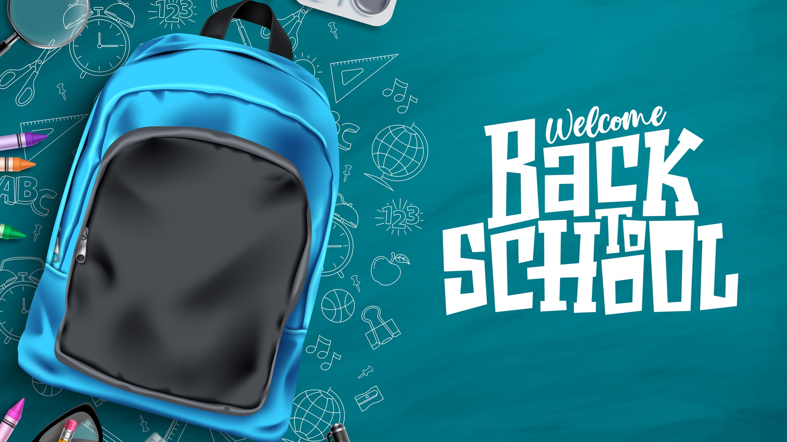
Back to School
5

Slide 6
6
As Americans prepare for the start of a new school year, many have gotten a jump start on back-to-school shopping, with 37% of their planned purchases already completed. Looking forward, children will command the lion’s share of the purchasing but are not the only consideration on back-to-school shoppers minds.
What percent of back-to-school shopping have you already completed?
For whom will you be buying back-to-school supplies or apparel? Select all that apply.
Notes:
As American children gear up to return back-to-school
45% of Americans shopping back-to-school
What percent of parents are planning to shop for school supplies or apparel?

Slide 7
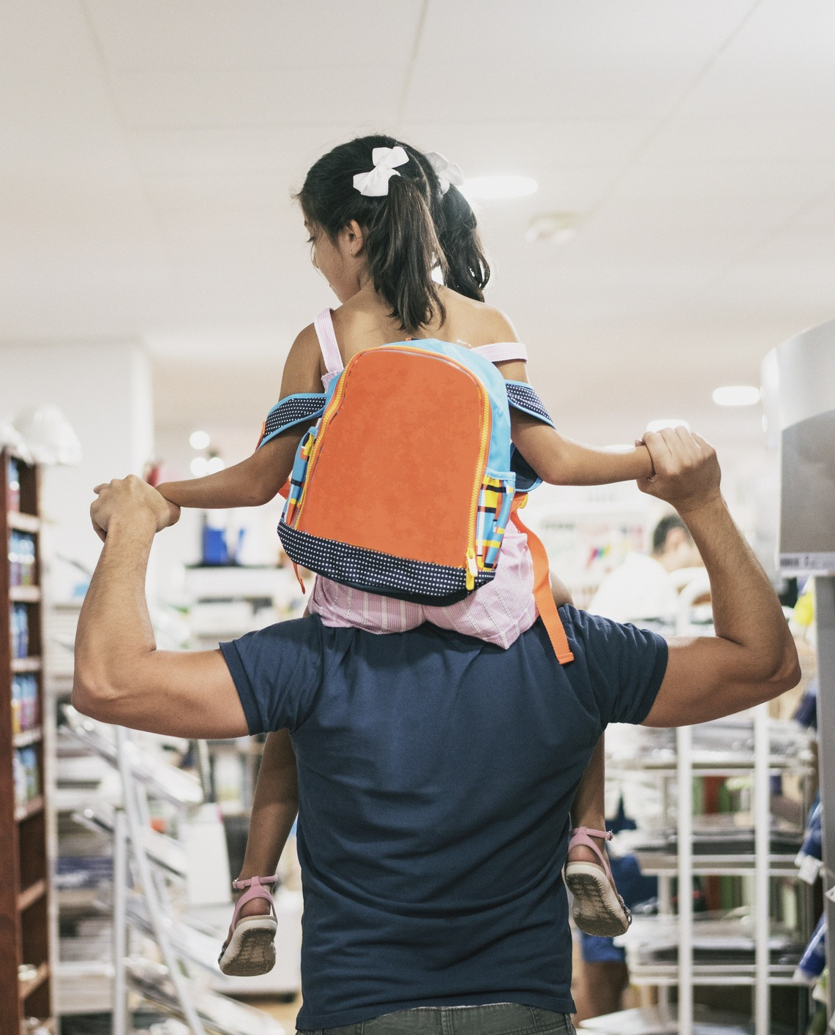
Not surprisingly, with inflation continuing to dominate the news cycle, planned spending is up this year. 70% plan to spend at least $200 and the share of people that plan to spend $500 or more has climbed to 25% in 2022.
How much do you expect to spend on back-to-school items?
Notes:
Not surprisingly, with inflation continuing to dominate the headlines, planned spending is up this year. 70% plan to spend at least $200 and the share of people that plan to spend $500 or more has climbed to 25%

Slide 8
8
And 67% have delayed purchasing products across other general categories in an effort to get better deals through back-to-school sales.
Are there other purchases you’ve been planning but are waiting for back-to-school sales to get the best possible price?

Slide 9
Consumers are indicating that they’ll be spending a slight majority (60%) of their back-to-school shopping in-store.
Back-to-school Shopping
What % of your shopping for back-to-school items will be done in-store and what % of your shopping will be done online?

Slide 10
Back to School Supplies
10

Slide 11
11
The most common back-to-school supplies on the list are the old standbys: Pens/pencils (87%), notebooks (84%), paper (73%), and backpacks (63%). As a reminder that COVID-19 has caused a new normal, hand sanitizer and disinfecting wipes appear on many back-to-school shoppers’ lists.
Which school supply items (K-12 or college and beyond) have/will you be purchasing for the upcoming school year? Select all that apply.

Slide 12
12
Walmart (86%) tops the list of retailers for back-to-school supplies followed by Amazon (57%) and Target (47%).
Which retailers are you likely to shop for back-to-school supplies? Select all that apply.

Slide 13
13
Back-to-school supply shoppers are leveraging retail, both in-store and online, as a learning resource more than they do friends and family and online ratings and reviews.
How helpful do you find the following sources when it comes to researching or learning about back-to-school supplies?

Slide 14
14
Half of back-to-school shoppers indicate they’ll be shopping for the best deals (50%). Millennials and Gen Z are slightly more likely to stick to a budget, with Gen Z most likely to itemize their budget.
Which of the following best describes your approach to budgeting school supply spending?

Slide 15
15
Among those purchasing back-to-school supplies, half claim they’ll spend the same amount as last year, while 29% plan to spend more (led by younger generations) and 21% plan to spend less.
Are you planning to spend more or less this year on school supply purchases than you did last year?

Slide 16
16
Of those consumers who plan to spend more on back-to-school supplies, 78% state it will be due in part to items being more expensive due to inflation.
Are you planning on spending more because you need more or because you expect things to be more expensive?

Slide 17
17
Good news for brands: 55% of those purchasing back-to-school supplies indicate they would be willing to go to a different retailer to find the item they are looking to purchase. Only 7% claim they would buy a different in-stock brand.
What action would you take if the school supply item you want to purchase is out of stock in-store?

Slide 18
Back to School Apparel
18

Slide 19
19
Back-to-school apparel shoppers plan to purchase many categories, led by shoes (88%), tops (88%), and pants/shorts/skirts (86%). 1 in 3 shoppers are looking ahead to cooler weather and preparing for the fall/winter season by purchasing coats (34%).
Which school apparel items have/will you be purchasing for the upcoming school year? Select all that apply.

Slide 20
20
Among those shopping for back-to-school apparel, Walmart (80%) is the most likely destination with Amazon (61%) and Target (53%) rounding out the top three retailers.
Which retailers are you likely to shop for back-to-school apparel?
Select all that apply.

Slide 21
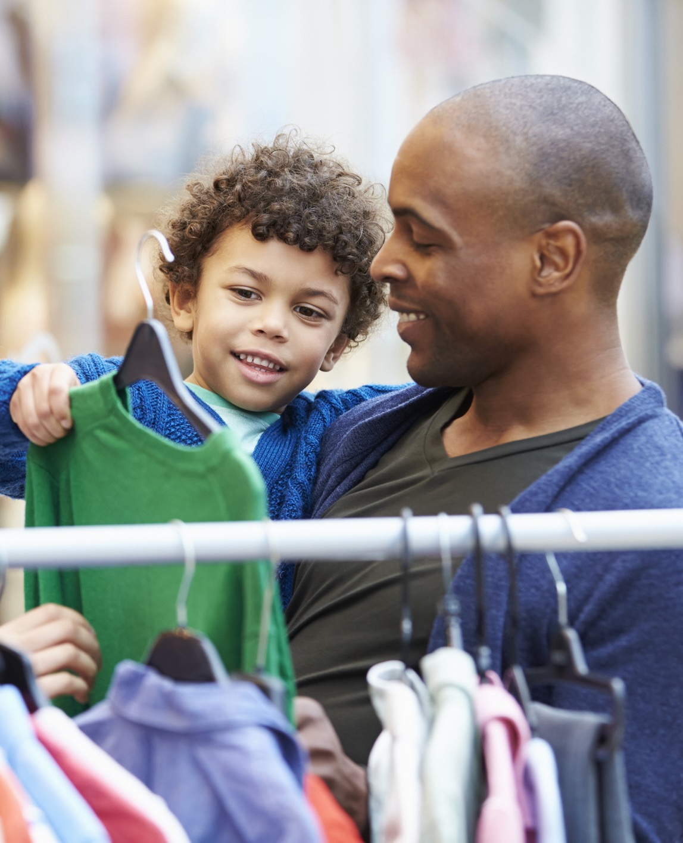
21
A well-organized and merchandised in-store presentation and website play a large role in the consumer shopping experience. Back-to-school apparel shoppers rely on retailers’ in-store resources (84%) such as merchandising and trying on products as well as the retailer website (82%) and brand websites (78%) to help inform their decisions.
How helpful do you find the following sources when it comes to researching or learning about back-to-school apparel?

Slide 22
22
Similar to back-to-school supply shopping behaviors, about half (47%) of apparel purchasers indicate they are shopping for deals, while the other half have a budget they will stick to, with Gen Z over-indexing on itemizing their budget.
Which of the following best describes your approach to budgeting for back-to-school apparel purchases?

Slide 23
23
Among those purchasing back-to-school apparel, 41% claim they’ll spend the same amount as last year, while 37% plan to spend more and 23% plan to spend less.
Are you planning to spend more or less this year on back-to-school apparel than you did last year?

Slide 24
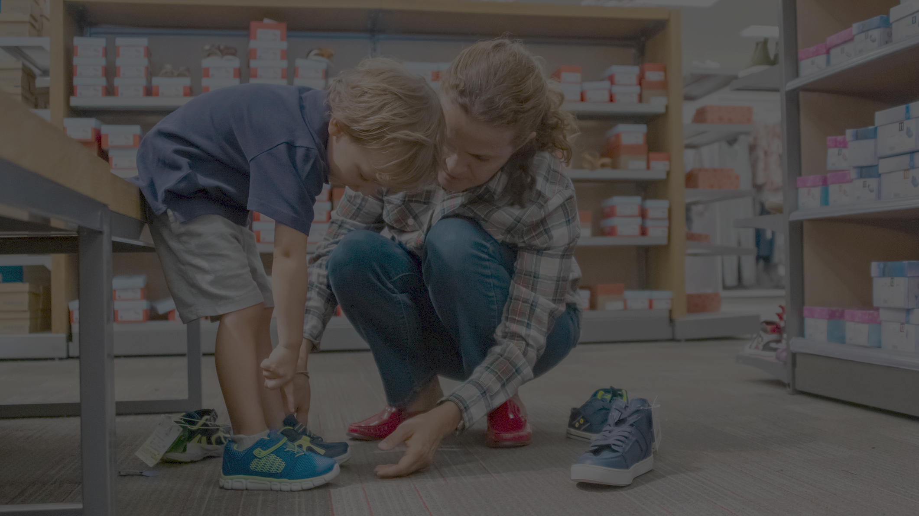
24
Of those who are spending less on back-to-school apparel, 88% cite the impact of inflation and 83% state their worry about the possibility of a recession as key contributing factors.
88%
83%
How influential are the following on your decision to spend less on apparel?

Slide 25
25
And not surprisingly, those who intend to spend more are likely to cite rising costs over their need for more school apparel. Millennials, however, skew higher on the need for more apparel.
Are you planning on spending more because you need more or because you expect things to be more expensive?

Slide 26
Summary
26
Many consumers have already started their back-to-school shopping, with 37% of planned purchases already completed. Among those shopping for school-related items, 65% are purchasing for their children.
70% plan to spend at least $200 and the share of people that plan to spend $500 or more has climbed to 25%.
2 in 3 consumers (67%) will be shopping back-to-school sales for other general items that they have delayed purchasing in order to get a deal.
Back-to-school shoppers plan to spend 60% in-store and 40% online.
The most common back-to-school supplies on the shopping list are the old standbys (pens/pencils/markers, notebooks, paper) but as a reminder that COVID-19 has caused a new normal, hand sanitizer and disinfecting wipes appear on many back-to-school shoppers’ lists.
Walmart (86%) tops the list of retailers for back-to-school supplies followed by Amazon (57%) and Target (47%).
Back-to-school supply shoppers are leveraging retail, both in-store and online, as a learning resource more than friends/family and online ratings/reviews.
Back-to-school

Slide 27
Summary
27
Half of back-to-school shoppers indicate they’ll be shopping for the best deals (50%). Millennials and Gen Z are slightly more likely to stick to a budget, with Gen Z most likely to itemize their budget.
Among those purchasing back-to-school supplies, half claim they’ll spend the same amount as last year, while 29% plan to spend more (led by younger generations) and 21% plan to spend less.
Of those spending more on back-to-school supplies, 78% state it will be due in part to items being more expensive due to inflation.
Good news for brands: 55% of those purchasing back-to-school supplies indicate they would be willing to go to a different retailer to find the item they are looking to purchase. Only 7% claim they would buy a different in-stock brand.
While shoes (88%), tops (88%), and pants/shorts/skirts (86%) are the top 3 categories being purchased during the back-to-school season, 1 in 3 shoppers are planning for the fall/winter season and purchasing coats (34%).
Among those shopping for back-to-school apparel, Walmart (80%) is the most likely destination with Amazon (61%) and Target (53%) rounding out the top three retailers.
Back-to-school
– cont.

Slide 28
Summary
28
A well-merchandised in-store presentation and website play a large role in the consumer shopping experience. Back-to-school apparel shoppers rely on retailers’ in-store resources (84%) such as merchandising and trying on products as well as the retailer website (82%) and brand websites (78%) to help inform their decisions.
Similar to back-to-school supply shopping behaviors, about half (47%) of apparel purchasers indicate they are shopping for deals, while the other half have a budget they will stick to, with Gen Z over-indexing on itemizing their budget.
Among those purchasing back-to-school apparel, 41% claim they’ll spend the same amount as last year, while 37% plan to spend more and 23% plan to spend less.
Of those who are spending less on back-to-school apparel, 88% cite the impact of inflation and 83% state their worry about the possibility of a recession as key contributing factors.
And not surprisingly, those who intend to spend more are likely to cite rising costs over their need for more school apparel. Millennials, however, skew higher on the need for more apparel.
Back-to-school
– cont.

