Slide 1
Home Retail Monitor
August 23, 2022

Slide 2
Methodology
N = 863
MOE ± 3.336%
Panel: General Population
Collected: 8/12/22, 8/13/22

Slide 3
21%
17%
24%
38%

Slide 4
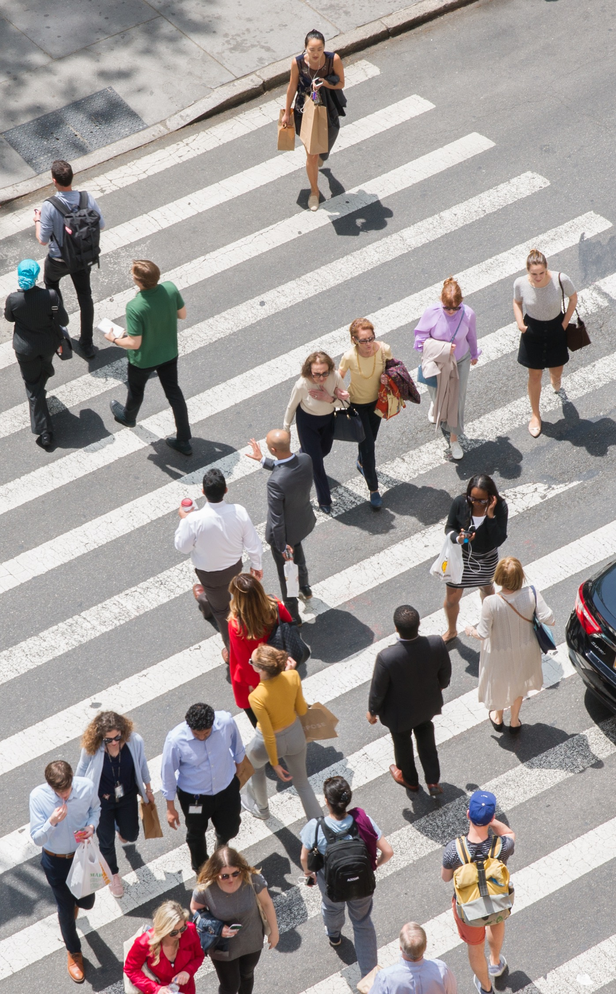

Slide 5
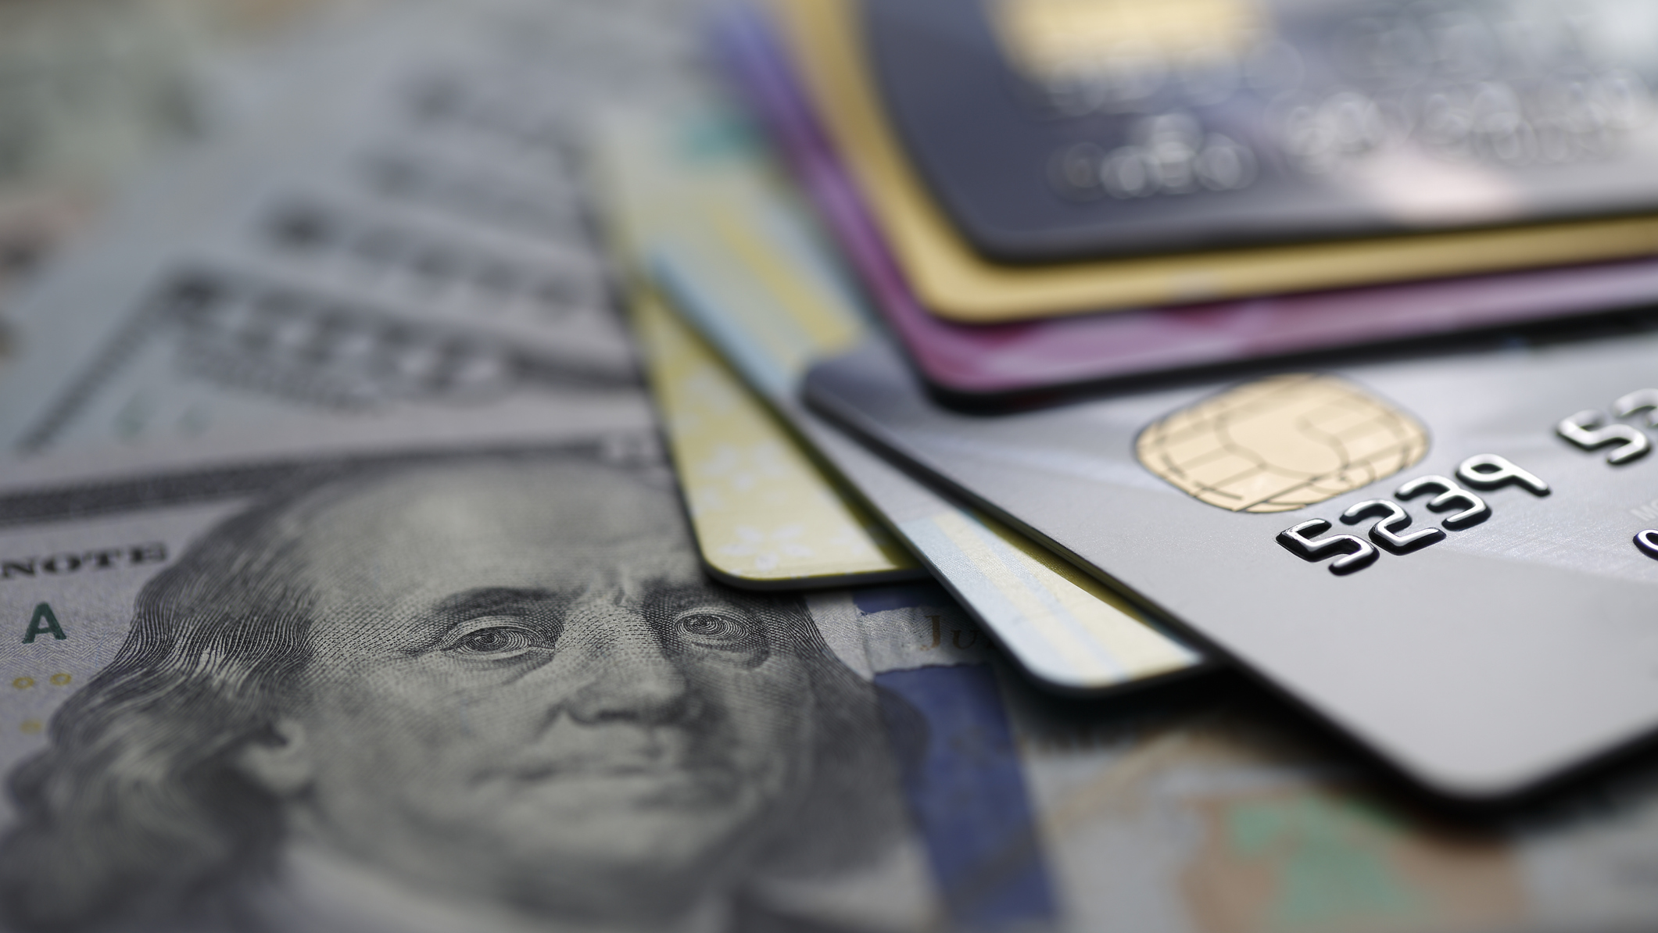
Prices and Spending
5

Slide 6
6
More than 4 in 5 respondents (82%) have noticed the decline in prices at the pump.
Have you noticed the price of gasoline has come down in the past month?

Slide 7
7
40% of respondents expect to see gas prices continue to decline in the coming months while 31% expect gas prices to go back up.
What do you think will happen to the price of gas in the coming months?

Slide 8
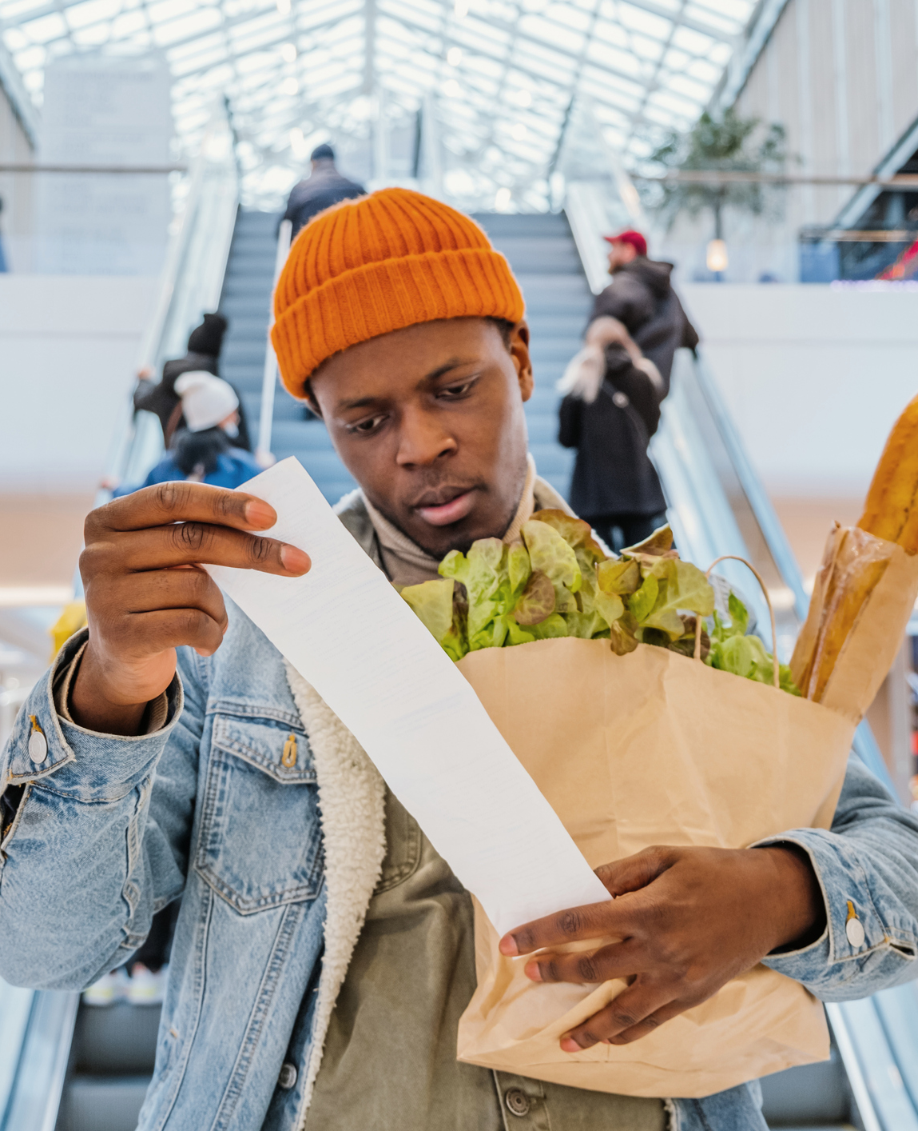
8
While declining gas prices are recognized, respondents are not seeing a decline on other everyday items.
Have you noticed a decline in the prices of everyday items like groceries, cleaning products, etc., that you purchase frequently?

Slide 9
9
Only 1 person in 5 (20%) expects prices on everyday items to decline in the coming months.
What do you expect will happen to the price of everyday items in the coming months?

Slide 10
10
As a result of the decline in gas prices, nearly one-third (31%) of respondents have changed their purchasing or saving strategy.
The national average price of regular gas is now below $4 per gallon compared to the record high of $5 in mid-June. As a result of the lower gas prices, have you changed any of your spending or saving habits?

Slide 11
11
Among those who’ve made changes to their spending/saving behavior, Boomers (52%) are much more likely than other generations to be spending rather than saving.
Which of the following changes have you made to your spending or saving habits? Select all that apply.

Slide 12
12
More than half of the sample (55%) report having delayed purchases because of the high gas prices.
Are there purchases that you had planned to make in the past 6 months that you didn’t make because of the high prices of gas and other items?

Slide 13
13
Among those who have delayed purchases, 37% now feel more comfortable spending the money.
Do you feel more comfortable making those purchases now than you did a month or two ago?

Slide 14
14
The categories that will benefit most from the relaxed spending behaviors are clothes and shoes (63%) and electronics (54%).
In which of the following categories have you delayed purchases that you are comfortable making now? Select all that apply.

Slide 15
15
Nearly half of the respondents (49%) delayed personal travel because of inflation.
In the past few months have you delayed personal travel or a vacation because of the high price of everyday items and travel?

Slide 16
16
Among those who have delayed travel, 1 in 3 (34%) now feel comfortable incurring the expense.
Are you comfortable enough now with the way prices are going to do the traveling you delayed?

Slide 17
17
Similar to lower ticket purchases and travel, 48% of respondents report having delayed a big-ticket purchase because of their financial concerns.
Have you delayed any major purchases (car, home improvements, etc.) because of concerns about the price of everyday items or the performance of your investments?

Slide 18
18
Among those who delayed big-ticket purchases, only 28% feel confident enough in their financial situation to incur the expense now.
Are you confident enough in what is happening to prices and your investments to go ahead and make those major purchases now?

Slide 19
19
The 72% of respondents who will continue to delay a major purchase are almost evenly split on how long prices will need to decline before they’re comfortable with the spending. 54% of respondents need prices to decline for 6 months or less while 46% need a downward trend of more than 6 months.
How much longer do prices need to decline before you’ll be confident enough to make the major purchases that you’ve delayed?

Slide 20
Housing
20

Slide 21
21
17% of respondents reported considering a new home purchase last year that they did not make.
Did you consider buying or did you plan to buy a house in the past year?

Slide 22
22
Among the many obstacles people faced, home prices (72%) and mortgage interest rates (63%) were the most concerning.
How influential were the following in your decision to not purchase a new house?

Slide 23
23
Nearly half of the respondents (44%) feel home prices will continue to increase in the coming year while only 17% feel prices will decline.
What do you think will happen to the prices of houses in the area in which you’d like to live over the next year?

Slide 24
24
1 in 5 potential buyers feels home prices need to decline 20% or more before they’ll be comfortable making a purchase.
How much do housing prices have to decline for you to feel comfortable buying a house?

Slide 25
25
Attitudes about the movement of interest rates in the coming months varies significantly. 35% expect rates to continue to rise while 21% expect they’ll decline and 44% expect them to remain the same.
What do you think will happen to mortgage interest rates in the coming year?

Slide 26
Summary
26
More than 4 in 5 respondents (82%) have noticed the decline in prices at the gas pump.
40% of respondents expect to see gas prices continue to decline in the coming months while 31% expect gas prices to go back up.
While declining gas prices are recognized, respondents are not seeing a decline in prices on other everyday items.
Only 1 person in 5 (20%) expects prices on everyday items to decline in the coming months.
As a result of the decline in gas prices, nearly one-third (31%) of respondents have changed their purchasing or saving strategy.
Among those who’ve made changes to their spending/saving behavior, Boomers (52%) are much more likely than other generations to be spending rather than saving.
More than half of the sample (55%) report having delayed purchases because of the high gas prices.
Among those who have delayed purchases, 37% now feel more comfortable spending the money.
Prices and spending

Slide 27
Summary
27
The categories that will benefit most from relaxed spending behaviors are clothes and shoes (63%) and electronics (54%).
Nearly half of the respondents (49%) delayed personal travel because of inflation.
Among those who have delayed travel, 1 in 3 (34%) now feel comfortable incurring the expense.
Similar to lower ticket purchases and travel, 48% of respondents report having delayed a big-ticket purchase because of their financial concerns.
Among those who have delayed big-ticket purchases, only 28% feel confident enough in their financial situation to incur the expense now.
The 72% of respondents who will continue to delay a major purchase are almost evenly split on how long prices will need to decline before they’re comfortable with the spending. 54% of respondents need prices to decline for 6 months or less while 46% need a downward trend of more than 6 months.
Prices and spending – cont.

Slide 28
Summary
28
17% of respondents reported considering a new home purchase last year that they did not make.
Among the many obstacles people faced, home prices (72%) and mortgage interest rates (63%) were the most concerning.
Nearly half of the respondents (44%) feel home prices will continue to increase in the coming year while only 17% feel prices will decline.
1 in 5 potential buyers feels home prices need to decline 20% or more before they’ll be comfortable making a purchase.
Attitudes about the movement of interest rates in the coming months varies significantly. 35% expect rates to continue to rise while 21% expect they’ll decline and 44% expect them to remain the same.
Housing

