Slide 1
Home Retail Monitor
September 21, 2022

Slide 2
Methodology
N = 731
MOE ± 3.625%
Panel: General Population
Collected: 9/9/22, 9/10/22

Slide 3
21%
17%
24%
38%

Slide 4
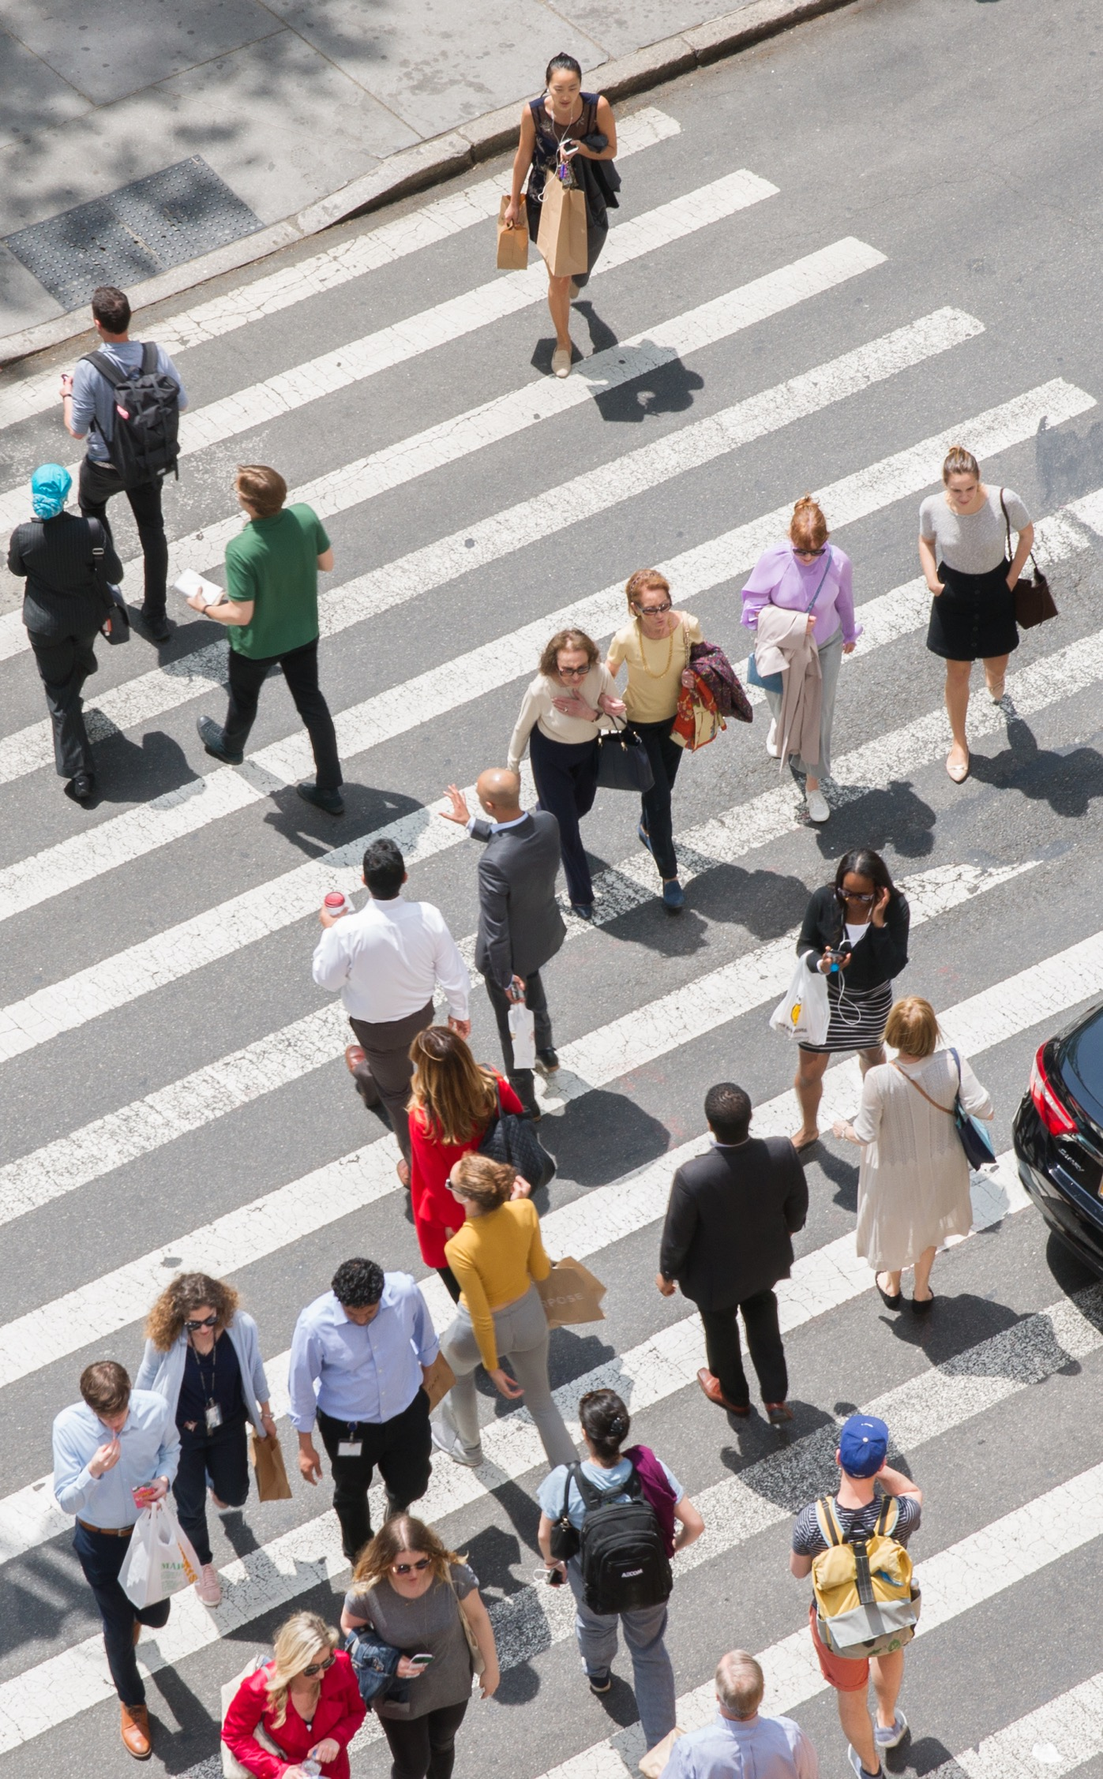

Slide 5
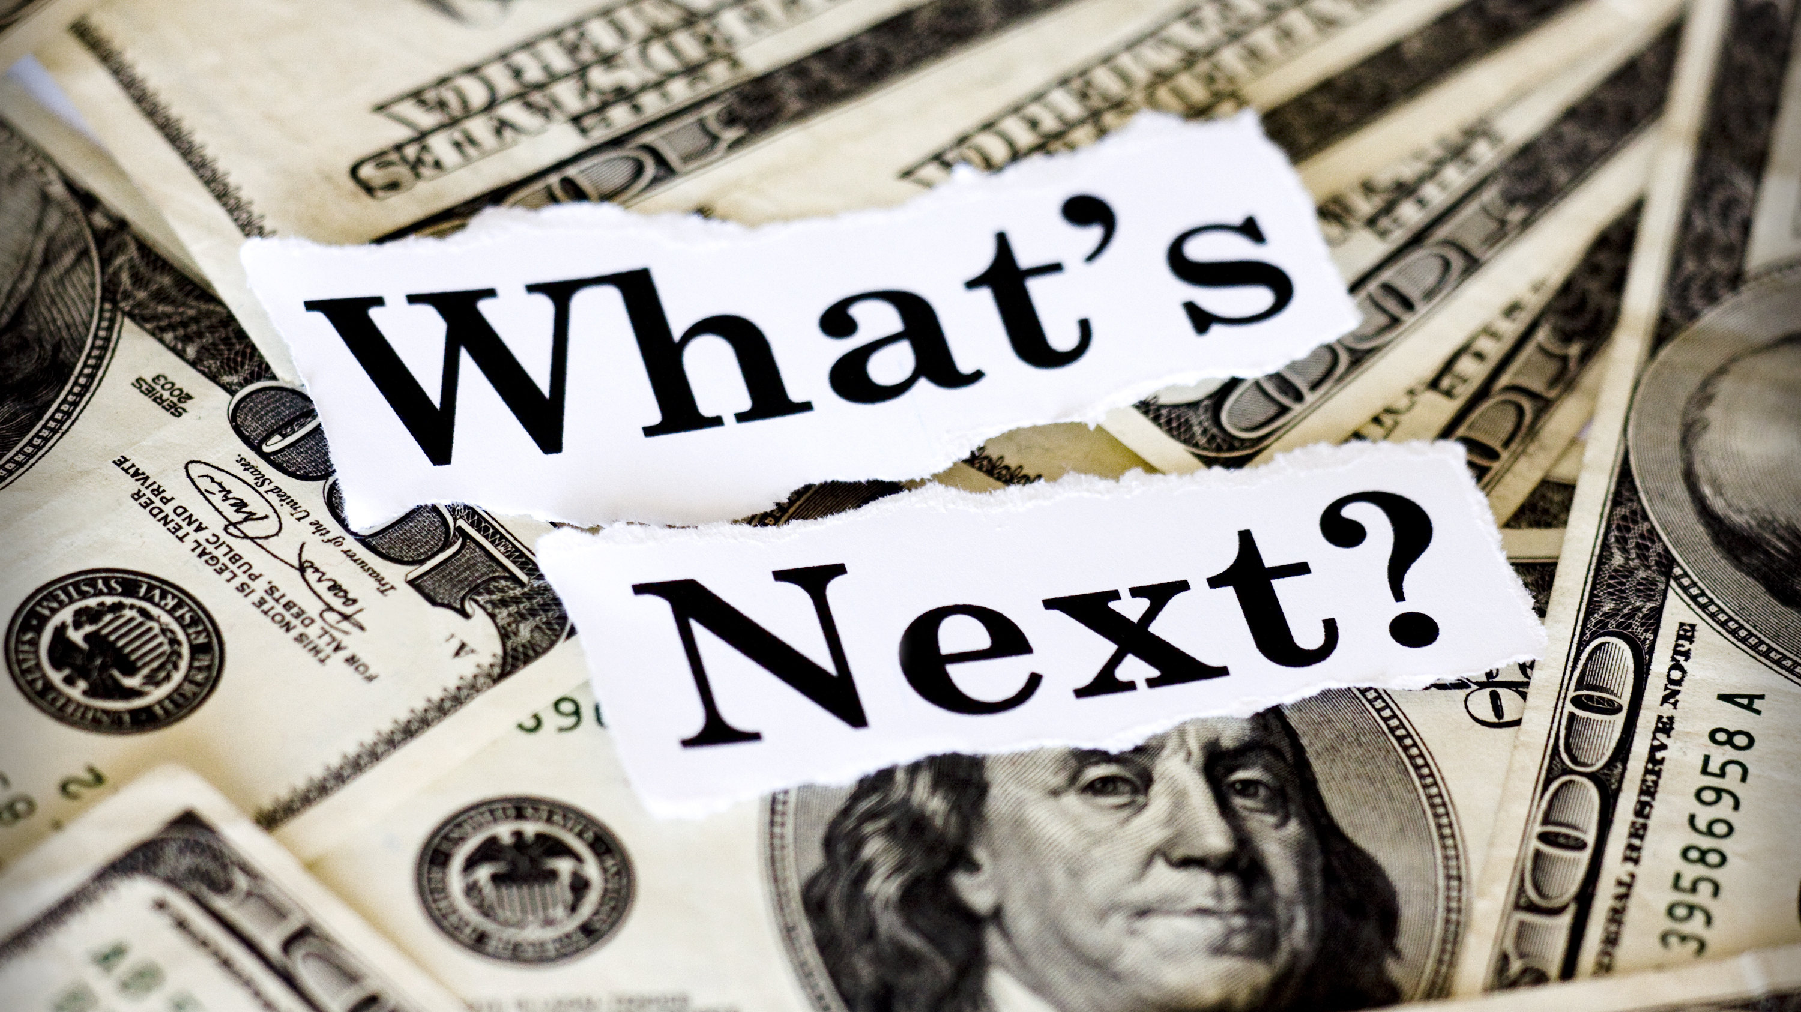
Inflation Expectations
5

Slide 6
6
Enthusiasm for the decline in gas prices is expected to be short lived as 64% of the sample expect prices to go up again.
Through the end of this year (the next 4 months), what do you think will happen with prices in these areas?

Slide 7
7
Given that 64% expect gas prices to go up, it’s somewhat surprising that 80% expect that food costs will continue to increase.
Through the end of this year (the next 4 months), what do you think will happen with prices in these areas?

Slide 8
8
Food is not an exception, as expectations of other frequently purchased items like clothes are equally bleak as 77% expect prices to increase.
Through the end of this year (the next 4 months), what do you think will happen with prices in these areas?

Slide 9
9
People also expect the cost of cars, where prices have largely been driven by semiconductor
chip shortages, to continue to increase (73%).
Through the end of this year (the next 4 months), what do you think will happen with prices in these areas?

Slide 10
In-store v. Online Shopping
10

Slide 11
11
Given the choice of only being able to shop online or in-store for non-essential goods, 56% of respondents chose in-store. Millennials were the only generation where a majority (55%) selected online.
Now that COVID has largely been brought under control, if you could only shop in one type of outlet for non-essential goods (items other than food, health and beauty aids, cleaning products, etc.) where would you shop?

Slide 12
12
Of respondents’ top 3 reasons for preferring to shop in-store, none were shared by as many as half of the respondents. The most popular reasons were the ability to inspect the products (45%) and immediacy (41%).
Which 3 of the following are most influential on your preference to shop in a store? Select 3.

Slide 13
13
There was also no consensus on the least influential reasons for selecting in-store. Only less concern about credit card security (38%) and getting out (36%) were selected by more than a third of respondents.
Which 3 of the following are least influential on your preference to shop in a store? Select 3.

Slide 14
14
The things people would miss most about shopping online were avoiding crowds (39%) and checkout lines (38%) along with shopping from home (38%) and at off hours (38%).
What 3 things would you miss most about shopping online? Select 3.

Slide 15
15
Among the 44% of respondents who would prefer to shop online, the leading influences are very similar to the things in-store shoppers would miss about shopping online: the ability to shop from home (46%) at off hours (36%) and crowd avoidance (35%).
Which 3 of the following are most influential on your preference to shop online? Select 3.

Slide 16
16
The things those who prefer online shopping would miss most about the in-store experience are immediacy (46%) and the ability to inspect the products (45%).
What 3 things would you miss most about shopping in a store? Select 3.

Slide 17
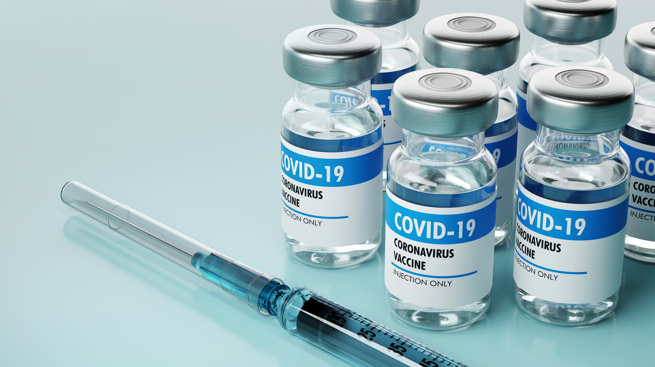
Vaccination Status
17

Slide 18
18
One person in 3 are not planning on getting a flu shot this year while nearly 1 in 10 (9%) are unsure what they’ll do.
Are you planning on getting a flu shot this year?

Slide 19
19
48% of respondents report getting a flu vaccination every year while 30% have gotten them in some years.
Have you gotten a flu shot in prior years?

Slide 20
20
Nearly half of the respondents (46%) think COVID cases will increase this winter while only 29% believe they’ll continue to decline.
What do you expect will happen with COVID cases this coming winter?

Slide 21
21
72% of respondents report having received at least 1 dose of the COVID vaccine. Less than half (43%) report having received both the initial doses and one or more boosters.
Have you received a COVID vaccine?

Slide 22
22
Slightly more than half of the respondents (51%) plan on getting the new COVID booster shot this fall.
Are you planning on getting the new COVID vaccine booster that will be available this fall?

Slide 23
Summary
23
Enthusiasm for the decline in gas prices is expected to be short lived as 64% of the sample expect the prices to go up again.
Given that 64% expect gas prices to go up, it’s somewhat surprising that 80% expect that food costs will continue to increase.
Food is not an exception, as expectations of other frequently purchased items like clothes are equally bleak as 77% expect prices to increase.
Respondents also expect the cost of cars, where prices have largely been driven by chip shortages, to continue to increase (73%).
Inflation Expectations

Slide 24
Summary
24
Given the choice of only being able to shop online or in-store for non-essential goods, 56% of respondents chose in-store. Millennials were the only generation where a majority (55%) selected online.
Of respondents’ top 3 reasons for preferring to shop in-store, none were shared by as many as half of the respondents. The most popular reasons were the ability to inspect the products (45%) and immediacy (41%).
There was also no consensus on the least influential reasons for selecting in-store. Only concern about credit card security (38%) and getting out (36%) were selected by more than a third of respondents.
The things people would miss most about shopping online were avoiding crowds (39%) and checkout lines (38%), along with shopping from home (38%) and at off hours (38%).
Among the 44% of respondents who would prefer to shop online, the leading influences are very similar to the things in-store shoppers would miss about shopping online: the ability to shop from home (46%) at off hours (36%) and crowd avoidance (35%).
The things those who prefer online shopping would miss most about the in-store experience are immediacy (46%) and the ability to inspect the products (45%).
In-store v. Online Shopping

Slide 25
Summary
25
One person in 3 are not planning on getting a flu shot this year while nearly 1 in 10 (9%) are unsure what they’ll do.
Only 48% of respondents report getting a flu vaccination every year while 30% have gotten them in some years.
Nearly half of the respondents (46%) think COVID cases will increase this winter while only 29% believe they’ll continue to decline.
72% of respondents report having received at least 1 dose of the COVID vaccine. Less than half (43%) report having received both the initial doses and one or more boosters.
Slightly more than half of the respondents (51%) plan on getting the new COVID booster shot this fall.
Vaccination Status

