Slide 1
Home Retail Monitor
April 20, 2022

Slide 2
Methodology
N = 775
MOE ± 3.52%
Panel: General Population
Collected: 4/8/22, 4/9/22

Slide 3
21%
18%
23%
39%

Slide 4
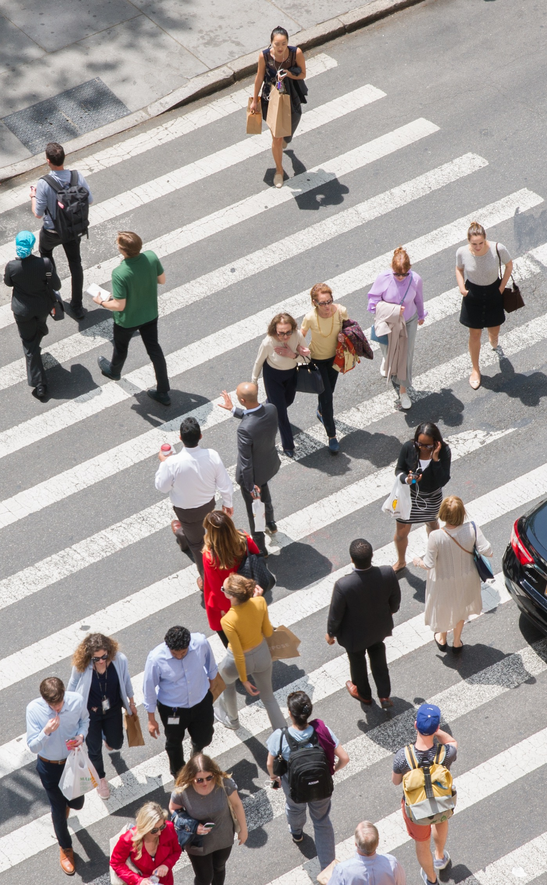

Slide 5
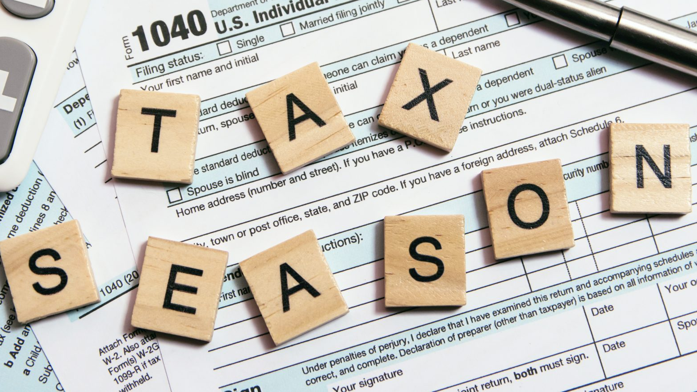
Taxes and refund use
5

Slide 6
6
As of 4/9, two-thirds of respondents had filed their 2021 tax returns.
Have you filed your 2021 income taxes yet?

Slide 7
7
Of those required to file, 64% are expecting or have received a refund.
Are you expecting or have you received a refund?

Slide 8
8
39% of respondents report having changed their plans for the use of their refund because of concerns about inflation.
Have your plans for the use of your refund changed because of the current rate of inflation?

Slide 9
9
Of those who’ve changed their plans for the use of the refund, 88% think they’ll need more of their refund to cover daily expenses.
Will you be using more of your refund to cover your everyday expenses?

Slide 10
10
52% will save more of their refund as a result of inflation concerns.
Will you be saving more of your refund because the rate of inflation makes you nervous about what the future might bring?

Slide 11
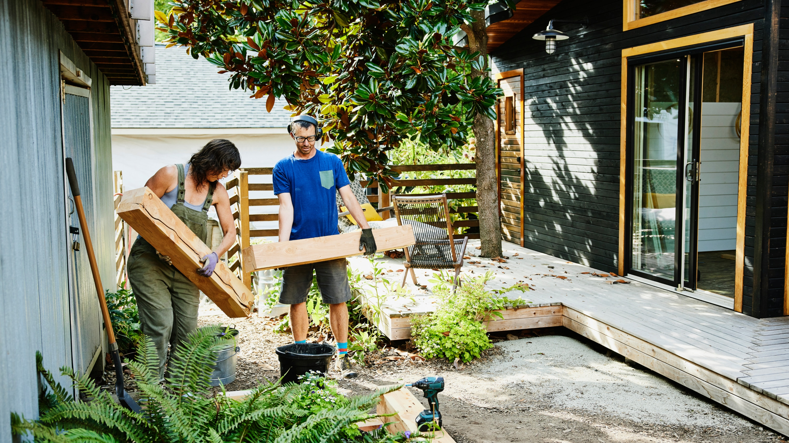
Outdoor Home Improvements
11

Slide 12
12
Half of the homeowners in the sample had outdoor home improvement plans for 2022.
At the beginning of the year did you have any outdoor improvements planned for your home this spring?

Slide 13
13
The leading planned outdoor projects were a new garden (43%), power washing (34%), and exterior painting (30%).
Which of the following outdoor improvements did you have planned for this spring? Check all that apply.

Slide 14
14
69% of those who planned a new garden will proceed as planned while the remaining 31% have changed their plans because of inflation and/or the war in Ukraine.
Please indicate which of the following best describes how you’ll approach the following planned improvements given the war in Ukraine and current inflation rate.

Slide 15
15
Similarly, 71% of those planning exterior painting will proceed as planned while 19% will proceed but spend less and 10% will delay the project.
Please indicate which of the following best describes how you’ll approach the following planned improvements given the war in Ukraine and current inflation rate.

Slide 16
16
Among those who planned power washing, only 2% will delay the project while 80% will proceed as planned.
Please indicate which of the following best describes how you’ll approach the following planned improvements given the war in Ukraine and current inflation rate.

Slide 17
COVID-19
17

Slide 18
18
Interest in COVID has clearly dissipated. At the height of the pandemic one-third of the sample was checking COVID news 5 or more times a week compared to 15% who are doing so now.
At the height of the COVID pandemic in December and January, how often did you check for COVID-related news? Currently, how frequently do you check for COVID-related news?

Slide 19
19
Google or a competing search engine are the most common source used for information on COVID (51%) followed closely by local TV or radio (50%).
Where have you typically gone to find information on COVID? Check all that apply.

Slide 20
20
Nearly 1 person in 4 (24%) has little or no confidence in the information they are receiving about COVID.
How confident are you in the information you are receiving about COVID now?

Slide 21
21
60% of respondents feel the information they receive from their doctor is trustworthy.
How trustworthy do you find the following sources of information about COVID?

Slide 22
22
44% of respondents are confident in the COVID information provided by their city/county health officials.
How trustworthy do you find the following sources of information about COVID?

Slide 23
23
Interestingly, fewer people (43%) are confident in the information from than CDC than that coming from their local health officials (44%).
How trustworthy do you find the following sources of information about COVID?

Slide 24
24
Only 37% are confident in the COVID information provided by the medical experts in the media.
How trustworthy do you find the following sources of information about COVID?

Slide 25
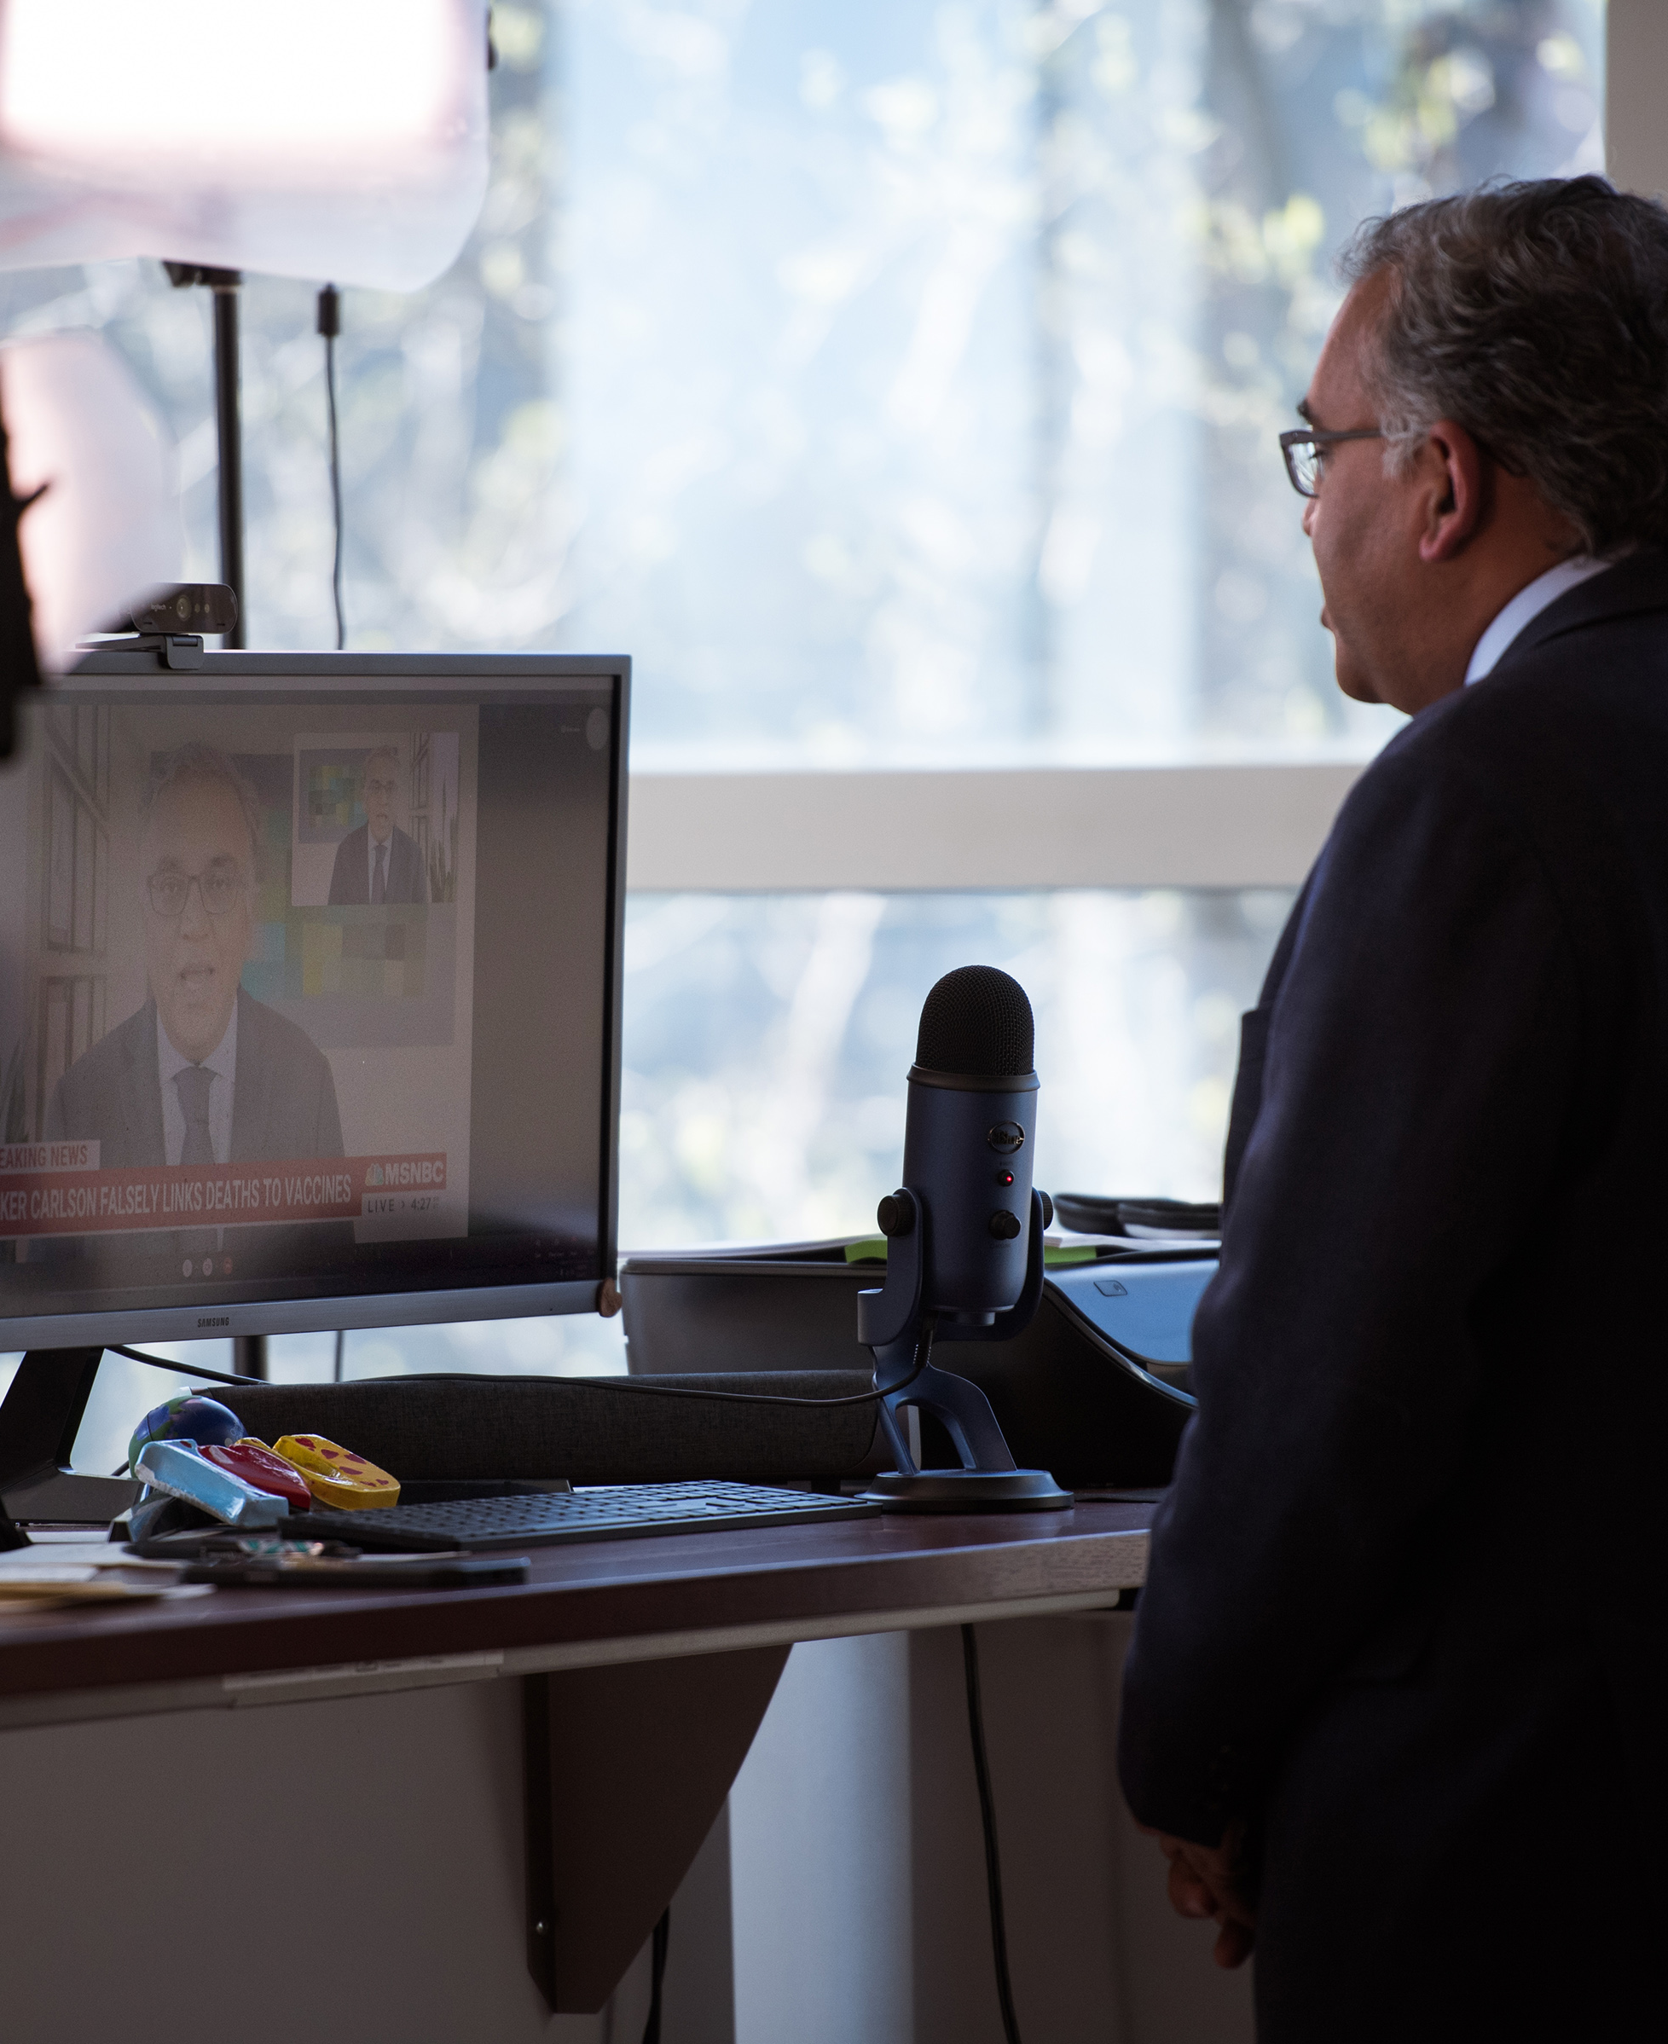
25
Only 37% are confident in the COVID information provided by the medical experts in the media.
How trustworthy do you find the following sources of information about COVID?

Slide 26
26
Confidence in the US medical community has declined somewhat as a result of COVID. 31% of respondents are less confident while 26% have seen their confidence increase.
In general, is your confidence in the U.S. medical community higher or lower than it was before COVID?

Slide 27
Summary
27
As of April 9th two-thirds of respondents had filed 2021 tax returns.
Of those required to file 64% are expecting or have received a refund.
39% of respondents report having changed their plans for the use of their refund because of concerns about inflation.
Of those who’ve changed their plans for the use of the refund, 88% think they’ll need more of their refund to cover daily expenses.
52% will save more of their refund as a result of inflation concerns.
Taxes and refund use

Slide 28
Summary
28
Half the homeowners in the sample had outdoor home improvement plans for 2022.
The leading planned projects were a garden (43%), power washing (34%) and exterior painting (30%).
69% of those who planned a new garden will proceed as planned while the remaining 31% have changed their plans because of inflation and/or the war in Ukraine.
Similarly, 71% of those planning exterior painting will proceed as planned while 19% will proceed but spend less and 10% will delay the project.
Among those who planned power washing only 2% will delay the project while 80% will proceed as planned.
Outdoor Home Improvements
Outdoor Home Improvements

Slide 29
Summary
29
Interest in COVID has clearly dissipated. At the height of the pandemic one-third of the sample was checking COVID news 5 or more times a week as opposed to 15% who are doing so now.
Google or a competing search engine are the most common source used for information on COVID (51%) followed closely by local TV or radio (50%).
Nearly 1 person in 4 (24%) has little or no confidence in the information they are receiving about COVID.
60% of respondents feel the information they receive from their Doctor is trustworthy.
44% of respondents are confident in the COVID information provided by their city/county health officials.
Interestingly, fewer people (43%) are confident in the information from than CDC than that coming from their local health officials (44%).
Only 37% are confident in the COVID information provided by the medical experts in the media.
Confidence in the US medical community has declined somewhat as a result of COVID. 31% of respondents are less confident while 26% have seen their confidence increase.
COVID-19

