Slide 1
Home Retail Monitor
May 4, 2022

Slide 2
Methodology
N = 755
MOE ± 3.57%
Panel: General Population
Collected: 4/22/22, 4/23/22

Slide 3
20%
18%
25%
37%

Slide 5
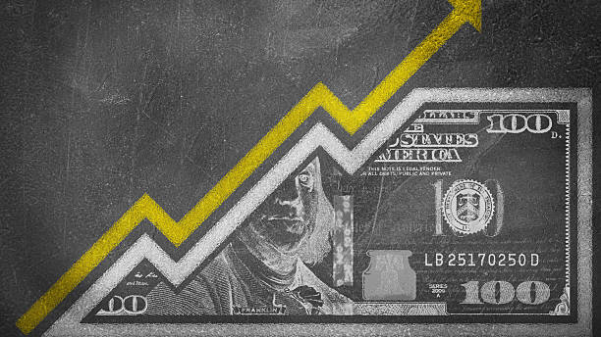
Inflation
5

Slide 6
6
More than two-thirds (69%) of respondents have cut spending on everyday items as a result of the increase in gas prices.
Has the increase in gas prices forced you to cut your spending on other everyday products (groceries, cleaning products, etc.)?

Slide 7
7
Among those looking to save, the two most popular areas are groceries (85%) and cleaning products (73%).
On which of the following everyday products will you attempt to save money? Select all that apply.

Slide 8
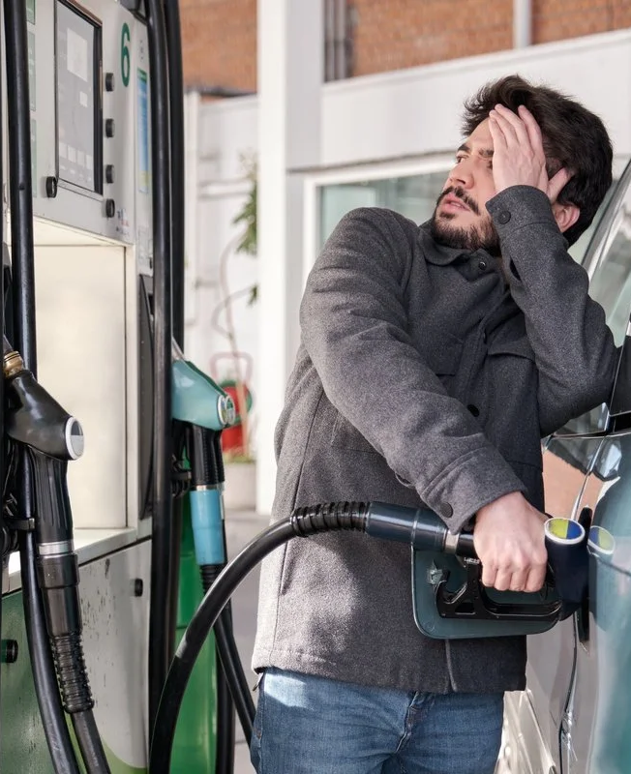
8
Nearly three respondents in four (71%) are concerned that they’ll see price increases in other categories similar to the ones they’ve witnessed in gas.
How concerned are you that price increases like the ones seen in gas will happen in other categories you buy regularly?

Slide 9
9
The recent declines in the stock market have 64% of respondents concerned about their savings and investments. Only 14% are not worried, the remaining 21% have no savings or investments.
The stock market has been negatively impacted by the war in Ukraine and inflation. How concerned are you about your savings/investments?

Slide 10
10
Despite the high level of concern about the financial markets, only 28% of respondents who have investments plan to change their strategy.
As a result of the downturn in the stock market have you changed or are you planning to change the way you save/invest?

Slide 11
11
As a result of inflation, 67% of respondents are planning a reduction of their discretionary spending.
As a result of inflation and the likelihood of higher inflation, are there categories other than everyday items (groceries, etc.) that you are planning on reducing your spending on?

Slide 12
12
Among the most popular areas to save are dining out (82%), entertainment (73%), and apparel purchases (68%).
In which of the following categories do you think you might reduce your spending? Select all that apply.

Slide 13
13
Major purchases will also take a hit as a result of inflation concerns with 53% of respondents planning to defer one or more purchases.
As a result of concerns about inflation are there any major purchases you were planning that you’ll wait to make?

Slide 14
14
Among those planning to delay a major purchase the most popular categories are cars (59%), travel, (57%) and electronics (54%).
In which of the following categories will you wait to make a purchase? Select all that apply.

Slide 15
Research vs. Purchase Location
15

Slide 16
16
A lack of experience in the power tool category is likely reflected in Gen Z shoppers, with 67% starting their category research in-store.
If you were planning a purchase in the following categories, where would you begin you research?

Slide 17
17
Despite being the most likely to initiate their power tool category research in-store, Gen Z is the least likely to complete their purchase in-store (48%).
Where do you think it is most likely that you would make a purchase in the following categories?

Slide 18
18
63% of respondents are most likely to initiate their electronics research online, with older generations (Boomer 63%, Gen X 69%) as likely or more so than the younger generations.
If you were planning a purchase in the following categories, where would you begin you research?

Slide 19
19
Despite a significant majority of Gen X and Boomers initiating research online, the majority of both generations (57%) would likely make their electronics purchase in store.
Where do you think it is most likely that you would make a purchase in the following categories?

Slide 20
COVID-19
20

Slide 21
21
More than half of respondents (59%) agreed with the judge who overturned the CDC mask mandate for public transportation.
A federal judge recently overturned the CDC mask mandate for public transit (air, train and bus travel). Do you agree with the judge’s ruling?

Slide 22
22
Among those who disagreed with the judge’s ruling, 79% agree with the Justice Department’s decision to appeal.
The Justice Department is going to appeal the mask ruling. Do you think they should proceed with the appeal or just leave it alone?

Slide 23
23
Interestingly, even though the majority of respondents agreed with the judge’s decision not to require masks, 64% of respondents would wear a mask if they were to use public transportation today.
If you were to travel on public transportation today, would you wear a mask?

Slide 24
24
In fact, only a little over one-third (34%) of respondents say they never wear a mask in indoor public spaces now.
Do you wear a mask when you are in indoor public spaces (stores, etc.) now?

Slide 25
25
Of those who are inclined to wear a mask, 37% say they feel that maskless people are judging them for doing so.
Do you feel that people are judging you or look down on you because you’re wearing a mask?

Slide 26
Summary
26
More than two-thirds (69%) of respondents have cut spending on everyday items as a result of the increase in gas prices.
Among those looking to save, the two most popular areas are groceries (85%) and cleaning products (73%).
Nearly three respondents in four (71%) are concerned that they’ll see price increases in other categories similar to the ones they’ve witnessed in gas.
The recent declines in the stock market have 64% of respondents concerned about their savings and investments. Only 14% are not worried, the remaining 21% have no savings or investments.
Despite the high level of concern about the financial markets, only 28% of respondents who have investments plan to change their strategy.
As a result of inflation, 67% of respondents are planning a reduction of their discretionary spending.
Among the most popular areas to save are dining out (82%), entertainment (73%), and apparel purchases (68%).
Inflation

Slide 27
Summary
27
Major purchases will also take a hit as a result of inflation concerns with 53% of respondents planning to defer one or more purchases.
Among those planning to delay a major purchase, the most popular categories are cars (59%), travel (57%), and electronics (54%).
Inflation – cont.

Slide 28
Summary
28
A lack of experience in the power tool category is likely reflected in Gen Z shoppers, with 67% starting their category research in-store.
Despite being the most likely to initiate their power tool category research in-store, Gen Z is the least likely to complete their purchase in-store (48%).
63% of respondents are most likely to initiate their electronics research online with older generations (Boomer 63%, Gen X 69%) as likely or more so than the younger generations.
Despite a significant majority of Gen X and Boomers initiating research online, the majority of both generations (57%) would likely make their electronics purchase in-store.
Research vs. Purchase Location

Slide 29
Summary
29
More than half of respondents (59%) agreed with the judge who overturned the CDC mask mandate for public transportation.
Among those who disagreed with the judge’s ruling, 79% agree with the Justice Department’s decision to appeal.
Interestingly, even though the majority of respondents agreed with the judge’s decision not to require masks, 64% of respondents would wear a mask if they were to use public transportation today.
In fact, only a little over one-third (34%) of respondents say they never wear a mask in indoor public spaces now.
Of those who are inclined to wear a mask, 37% say they feel that maskless people are judging them for doing so.
COVID-19

