Slide 1
Home Retail Monitor
May 14, 2022

Slide 2
Methodology
N = 759
MOE ± 3.56%
Panel: General Population
Collected: 5/06/22, 5/07/22

Slide 3
21%
17%
24%
37%

Slide 5
Roe v. Wade
5

Slide 6
6
Many studies have demonstrated that most Americans are opposed to overruling the Roe v. Wade decision. Among those who do favor overruling the decision, most have one or more circumstances where they deem abortion appropriate led by risk to the mother’s health (62%) and rape (56%).
In which of the following situations do you think abortion should be allowed?

Slide 7
7
In those special situations where opponents of Roe v. Wade find abortion appropriate, the majority (57%) feel up to 15-24 weeks is an appropriate time to abort.
If an abortion is necessary because of special circumstances, how late in the pregnancy do you think it should be allowed?

Slide 8
8
62% of respondents feel it is appropriate for companies to support employees who have to seek abortions outside their state of residence.
Do you think it is appropriate for companies to support employees seeking an abortion?

Slide 9
9
The agreement that companies should support employees seeking abortions does not necessarily translate to sales, as only one-third of respondents are more likely to support a company based on the company’s position.
Would you be more or less likely to buy products or services from a company that has special programs to support employees seeking an abortion?

Slide 10
10
1 respondent in 4 says they are willing to contact a company they support to express their position on the abortion issue.
Would you ever contact a company or brand you support and ask them to take a stance on the abortion issue?

Slide 11
11
As opposed to those who look favorably on companies that support employees seeking an abortion, nearly one respondent in 3 (31%) feel states should take legal actions against those that do so.
Do you think states should take legal action against companies that put programs in place to help their employees get abortions in other states?

Slide 12
12
38% of respondents think it’s appropriate for companies to consider relocating out of the states that implement restrictive abortion laws.
Do you think companies should consider relocating their offices and other facilities out of states that have very restrictive abortion laws?

Slide 13
13
Men (42%) are somewhat more likely to favor companies relocating than are women (34%).
Do you think companies should consider relocating their offices and other facilities out of states that have very restrictive abortion laws?

Slide 14
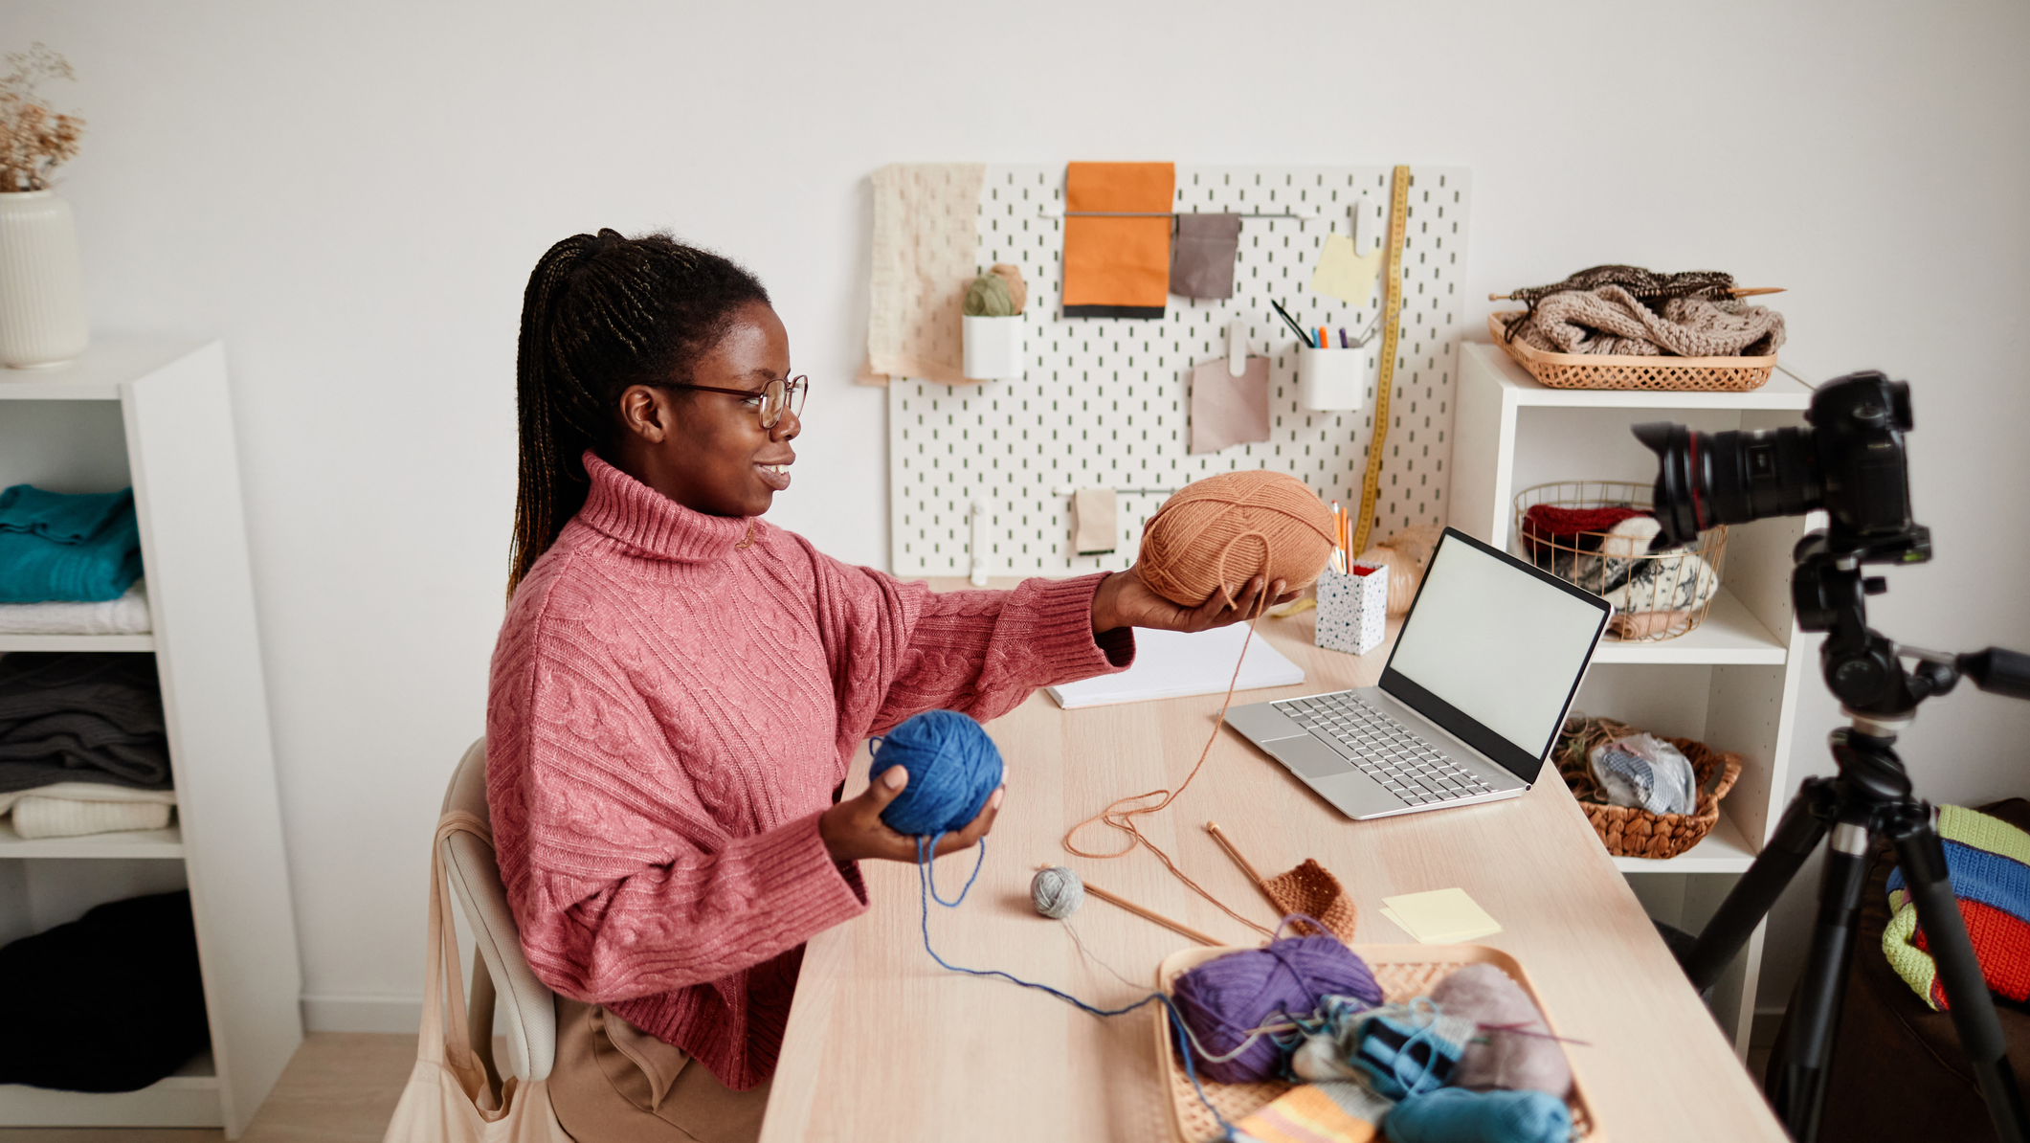
Hobbies
14

Slide 15
15
Hobby participation remains high, led by cooking (62%) and gardening (43%).
In which of the following hobbies do you participate?

Slide 16
16
Of those participating in the various hobbies, a significant percentage adopted or reengaged with the activity as a result of COVID.
Which of the following hobbies did you take up or go back to after a long absence because you had more time available during COVID shutdowns?

Slide 17
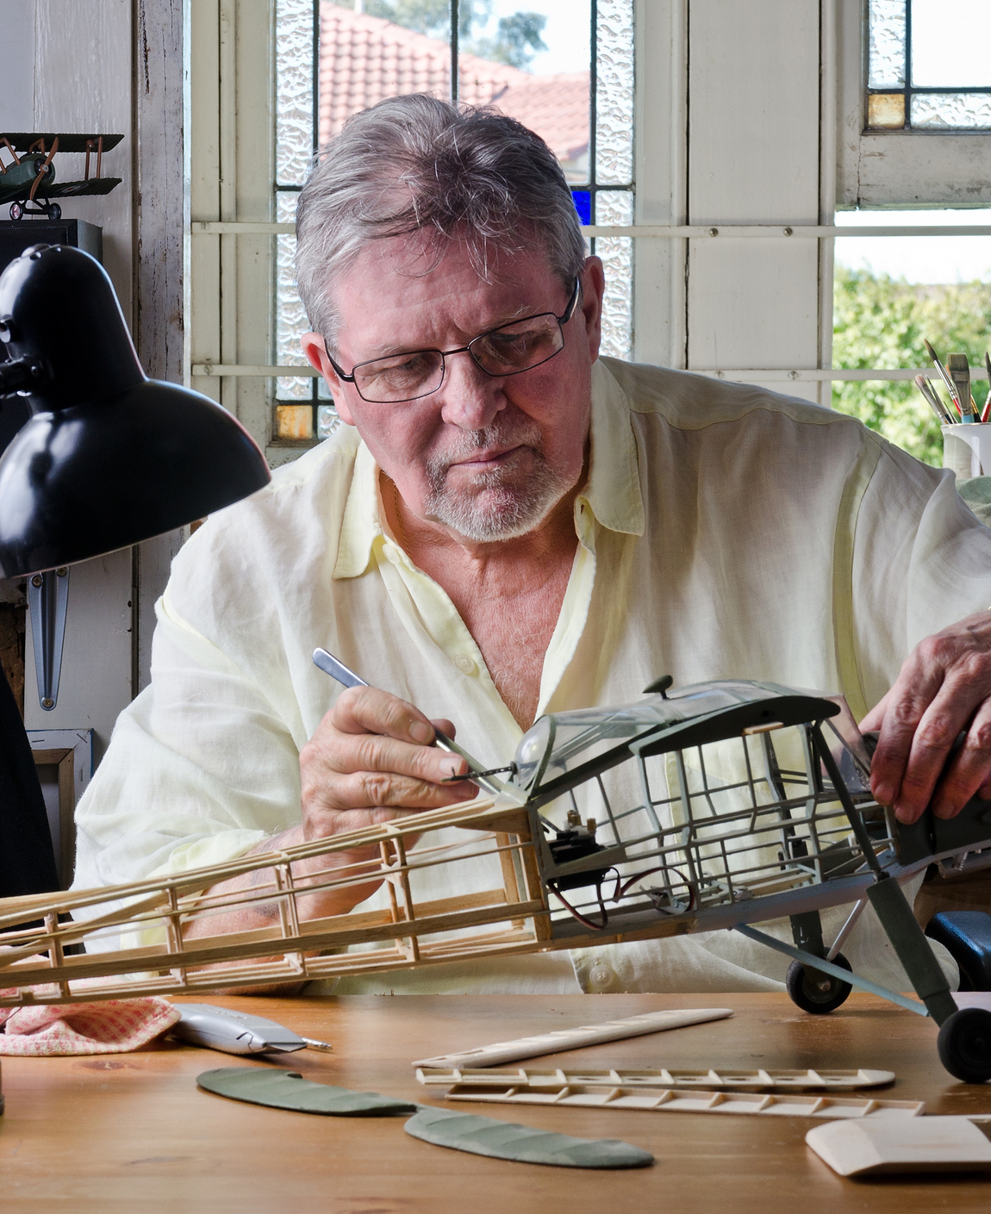
17
The level of engagement for many is quite high. 40% of those participating are spending more than 20 hours a month across all their hobbies.
Approximately how much time do you spend on your hobbies in an average month?

Slide 18
18
Hobby spending is also fairly substantial, with 1 in 5 respondents spending $1,000 or more annually.
Approximately how much money do you spend on your hobbies in an average year?

Slide 19
19
As popular as online shopping has become, only 33% of the identified hobbyists are doing 60% or more of their hobby shopping online.
Approximately what % of your hobby supplies do you buy in store or online.

Slide 20
20
Not surprisingly, discretionary spending on hobbies has been hurt by inflation, with 57% of participants curtailing their spending.
Have you cut back on the amount you spend on your hobbies because of inflation?

Slide 21
21
Of those who have reduced their hobby-related spending, 37% have eliminated it completely.
Are there hobbies you have stopped participating in because of inflation?

Slide 22
22
The future for the hobby industry isn’t all bleak. Not only can spending rebound when inflation is brought under control, but the average respondent thinks there is one new hobby they may take up in the future.
Which of these hobbies do you think you might take up in the future?

Slide 23
Summary
23
Many studies have demonstrated that most Americans are opposed to overruling the Roe v. Wade decision. Among those who do favor overruling the decision, most have one or more circumstances where they deem abortion appropriate led by risk to the mother’s health (62%) and rape (56%).
In those special situations where opponents of Roe v. Wade find abortion appropriate, the majority (57%) feel up to 15-24 weeks is an appropriate time to abort.
62% of respondents feel it is appropriate for companies to support employees who have to seek abortions outside their state of residence.
The agreement that companies should support employees seeking abortions does not necessarily translate to sales, as only one-third of the respondents are more likely to support a company based on the company’s position.
1 respondent in 4 says they are willing to contact a company they support to express their position on the abortion issue.
Roe v. Wade

Slide 24
Summary
24
As opposed to those who look favorably on companies that support employees seeking an abortion, nearly one respondent in three (31%) feel states should take legal actions against those that do so.
38% of respondents think it’s appropriate for companies to consider relocating out of the states that implement restrictive abortion laws.
Men (42%) are somewhat more likely to favor companies relocating than are women (34%).
Roe v. Wade – contd.

Slide 25
Summary
25
Hobby participation participation remains high, led by cooking (62%) and gardening (43%).
Of those participating in the various hobbies, a significant percentage adopted or reengaged with the activity as a result of COVID.
The level of engagement for many is quite high. 40% of those participating are spending more than 20 hours a month across all their hobbies.
Hobby spending is also fairly substantial, with 1 in 5 respondents spending $1,000 or more annually.
As popular as online shopping has become, only 33% of the identified hobbyists are doing 60% or more of their hobby shopping online.
Not surprisingly, discretionary spending on hobbies has been hurt by inflation, with 57% of participants curtailing their spending.
Of those who have reduced their hobby-related spending, 37% have eliminated it completely.
The future for the hobby industry isn’t all bleak. Not only can spending rebound when inflation is brought under control, but the average respondent thinks there is one new hobby they may take up in the future.
Hobbies

